Slide 1
Presented by Katie Fields, MEd. EdS. SWAG Family Resource Center Manager

Slide 2
SWAG
Service providers and leaders
Residents
Bringing services to SWAG neighborhoods
Advocates
A grassroots organization formalized in February 2010; non-profit as of August 2010.
Focused on issues affecting low-income residents of 32607.
Consists of SW Alachua County residents, advocates, and local agency providers.

Slide 3
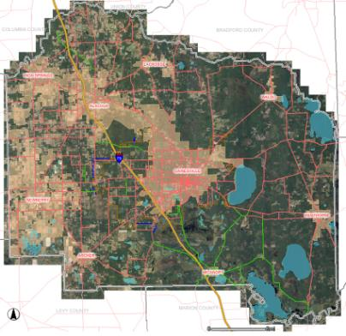
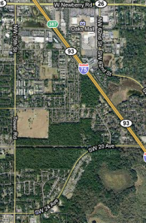
SWAG Neighborhoods
SWAG currently focuses on six neighborhoods
Harbor Cove
Hidden Oaks MHP
Holly Heights/Gordon Manor
Linton Oaks
Majestic Oaks
Tower Oaks

Slide 4
Issues and Needs Identified at 2/13/10 Community Focus Group
County Commission support
Local school buy-in
Business participation
Resident participation
Resource center space
Activity space
After school programs
Summer programs
Teen job preparation
Job/vocational training
Computers
Late bus schedules
Bus routes
Bus fare
Health care
Dental care
Medicaid quotas
Health Department wait times
Medivan criteria
Nutrition
Social service access
Sidewalks
Burglaries
Domestic violence
Assault/battery
Drug offenses
Child abuse
Robberies
Sexual offenders/predators
Child supervision
Voter registration
Candidate forums

Slide 5
The Reality
Issue themes:
Local government support
Institutional support
Community support
Support from neighbors
Access to resources
Social services
Education
Transportation
Health care
Nutritious foods
Recreation
Safety
Violence
Parenting
Representation

Slide 6
Strategies for Transformation
Issue themes:
Local government support
Institutional support
Community support
Support from neighbors
Access to resources
Social services
Education
Transportation
Health care
Nutritious foods
Recreation
Safety
Violence
Parenting
Representation
Strategies:
Gather data to present to the Board of County Commissioners
Meet with school board and local principals
Share data and ideas with local service providers
Identify gaps in services and issues with access
Recruit neighbors
Create a neighborhood resource center, playground, and health services clinic
Build responsibility and support within the community
Discuss politics – be seen and heard

Slide 7
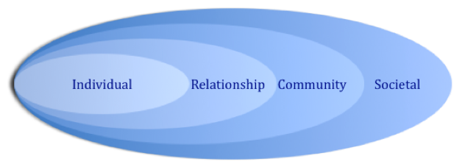
Socio-Ecological Model: SWAG Collective Efficacy
Limited access to resources such as social & educational services, transportation, health care, nutritious foods, & recreation
Peer & intimate partner violence, child abuse & neglect, safety issues, limited exposure to diverse individuals
Limited support from local government, institutions, businesses, & neighboring communities
Feel powerless & unrepresented due to inequalities in race, gender, age, economic status, & education
Reality
Explore individual, neighborhood & community assets; advocate for a resource center, playground, & health services clinic within the neighborhood
Recruit programming related to building & maintaining healthy relationships; increase responsibility; create opportunities for diverse experiences & mentoring
Collect data to speak the language of local policy makers & institutional leaders; build partnerships
Create grassroots organization to discuss realities, develop strategies, & advocate for resources that address issues of inequality
Strategies

Slide 8
Shifting At-Risk into At-Potential
Risk – chance of something going wrong
Loss
Danger
Hazard
Potential – capacity to develop, succeed, or become something
Possibility
Promise
Aptitude
Notes:
Essentially, risk and potential are the same. They are both about the opportunity for something to happen. Risk is viewed negatively, with connotations of loss, danger, and hazards. Potential is viewed positively, with connotations of possibilities, promise, and aptitude.

Slide 9
Shifting At-Risk into At-Potential
Potential
Risk
Capacity
Chance
Notes:
Capacity, or ability to engage in opportunities that place one at their potential.
Chance, or probability of engaging in opportunities that put one at-risk.
We want to reduce chances and increase capacities.

Slide 10
Shifting At-Risk into At-Potential
Risk
Potential
Chance
What provides balance? What is working?
Capacity
Notes:
If engaging in risky behaviors can lower potential, does engaging in potential building lower risk? Is balance the goal? What does balance look like? Do communities with an imbalance of potential look to add risk?

Slide 11
Mapping Community Assets
Individuals
Youth
Adults
Seniors
Neighborhood
Design
Amenities
Image
Community
Organizations
Institutions
Government
Opportunities
for Building Capacity
and Sustainability

Slide 12
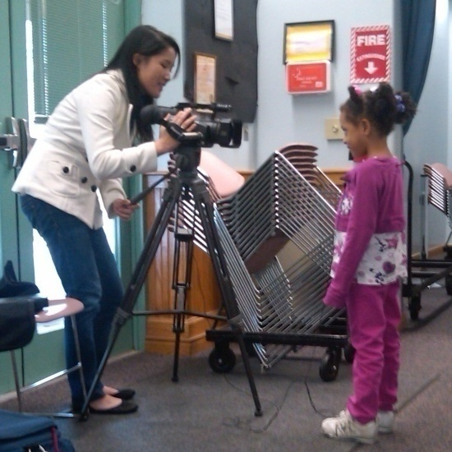
Individual Assets
Youth
Variety of ages
Eager to learn
Active
Interested in being future SWAG members
Adults
Variety of income levels
Variety of skill sets
Seniors
Skills
Time
Experience

Slide 13
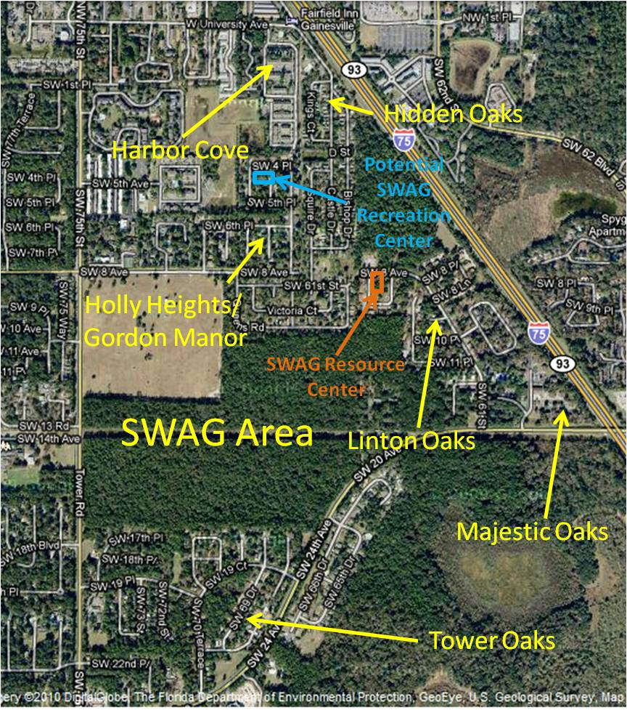
Neighborhood Assets
Design
Interconnected (informally)
SWAG Family Resource Center and Health Services Clinic in central location
Amenities
Recreation opportunities in every neighborhood
RTS transit
Image
Pride

Slide 14
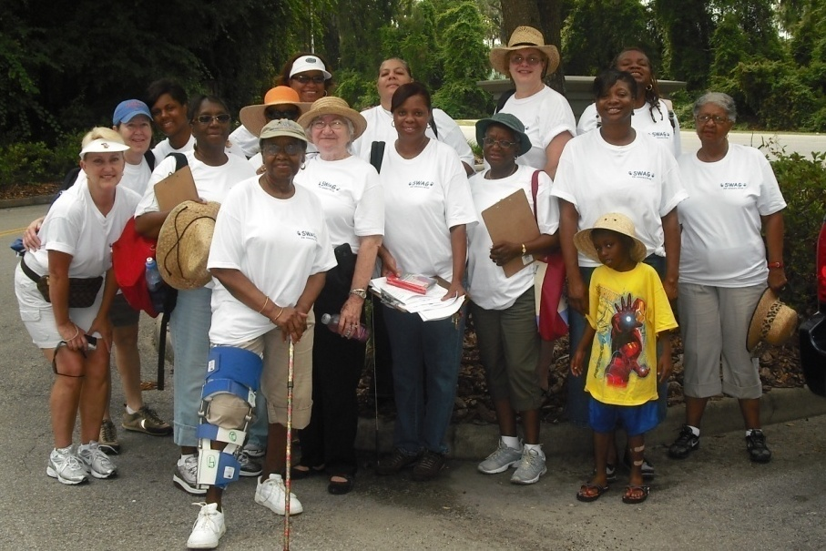
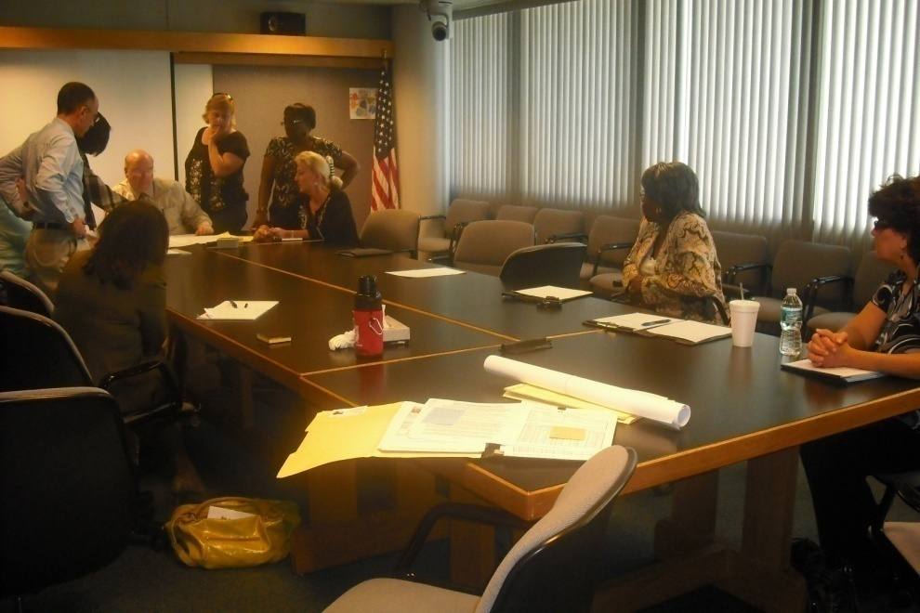
Community Assets
Organizations (other than SWAG and their partners)
Partnership for Strong Families
Rotary Club
Partners for a Productive Community
Veterans Advisory Board
UF HEROES
Businesses
Tower Hill Insurance Group
Skinner, Vignola, McLean, Inc.
CH2M Hill
Oelrich Construction
Institutions
Library District
University of Florida
Health Department
Public Schools
Government
Board of County Commissioners
Sheriff’s Office
Code Enforcement

Slide 15
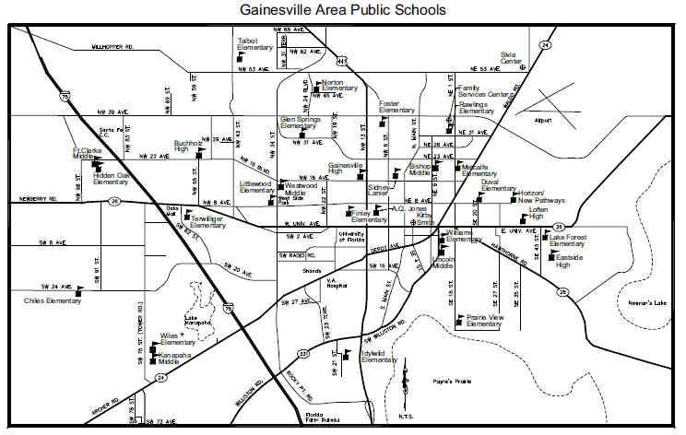
SWAG area

Slide 16
Parallel Paradigms
Building Community
Discussing realities
Developing strategies
Providing Services and Support
Assessing needs
Connecting to quality empowerment programming and services
Creating action
Identifying assets
Building stability through support and connections

Slide 17
Top 10 Community Concerns
Child maltreatment
Domestic violence
Health disparities
Lack of recreation for youth
Limited transportation and access to resources
Education disparities
Dense poverty
Crime
Gangs
Housing issues

Slide 18
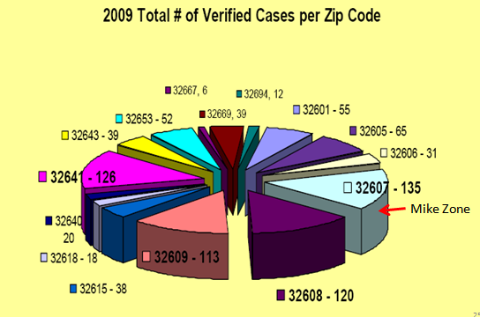
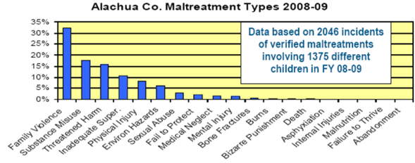
Child Maltreatment
32607 has the highest number of verified child maltreatment cases in the County.
The number one type of child maltreatment in 2009 was family violence.
There is an important connection between crime and health when discussing child maltreatment and family violence.
Data from DCF

Slide 19
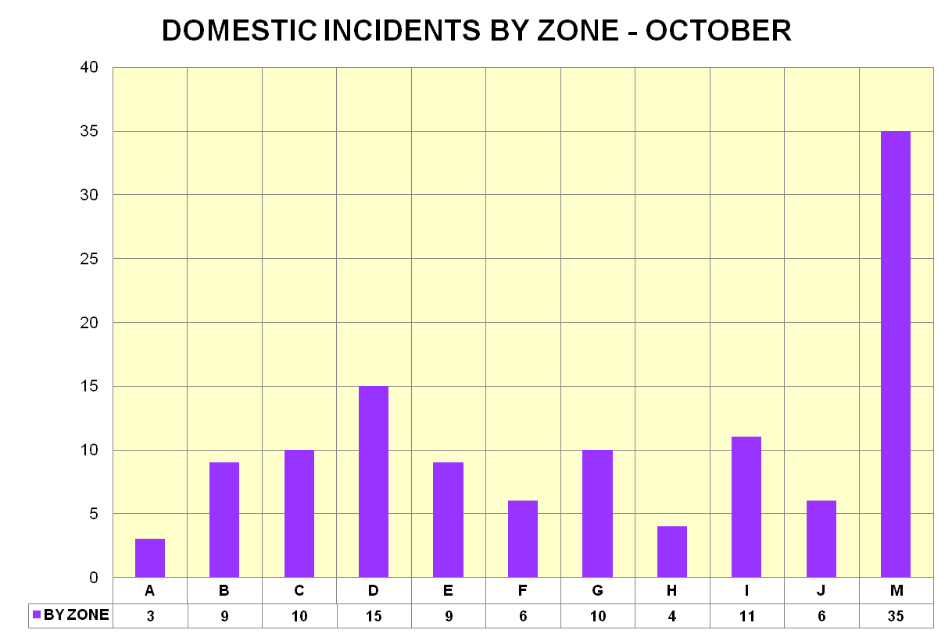
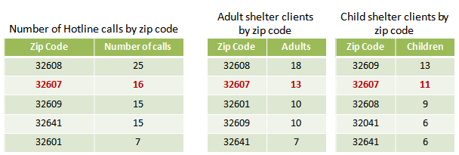
Domestic Violence
Mike Zone consistently provides the most number of domestic related calls for service and reports.
Peaceful Path’s data identifies 32607 as the source for the second highest number of calls to the domestic violence hotline and adult and child shelter clients.
Data from Peaceful Paths

Slide 20
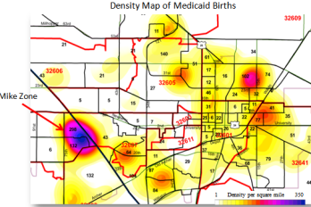
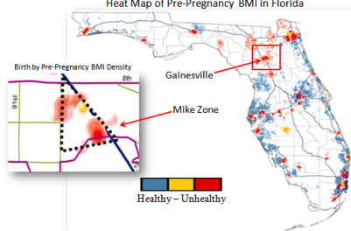
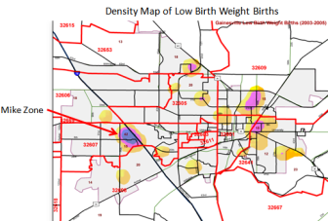
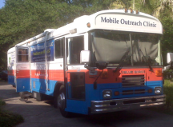
Health Disparities
Mike Zone
High number of Medicaid births.
Low number of Medicaid providers.
Unhealthy pre-pregnancy body mass index.
Many low birth weight babies.
Infant mortality higher than the national average.
High rates of Chlamydia.
High rates of Gonorrhea.

Slide 21
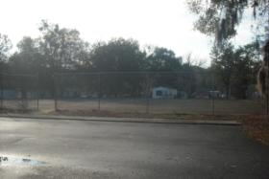
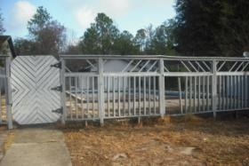
Lack of Recreation for Youth
Survey Results for Family Support/Child Development
In the summer 2010 door-to-door survey of Majestic Oaks and Linton Oaks, the number one need was activities for kids.
Residents believe kids will stay out of trouble if they have recreation and structured activities.
There are a number of dilapidated tennis courts in the area, but no basketball courts or fields to play football in.
Majestic Oaks
Linton Oaks

Slide 22
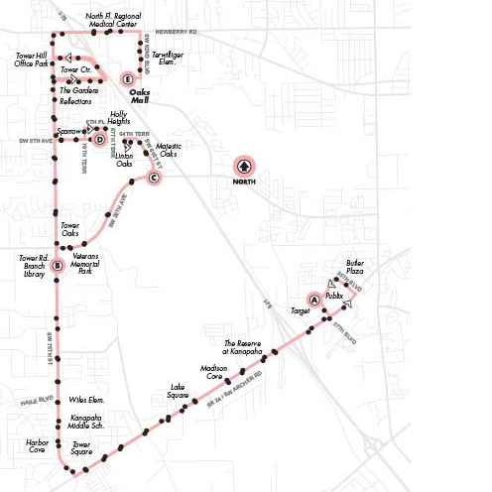
Limited Transportation and Access to Resources
SWAG neighborhoods are located on the number 75 bus route.
A trip to Kanapaha Park takes 20 minutes each way.
Walking takes 55 minutes.
A trip to Forest Park takes 30 minutes
Walking takes 32 minutes.
A trip to the Health Department in SE Gainesville takes 1 ½ hours each way on three different buses.
75 bus route

Slide 23
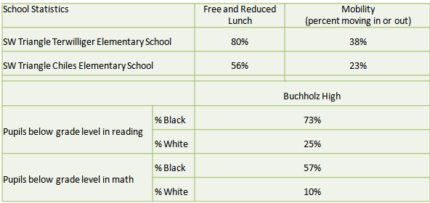
Education Disparities
Children in the SWAG neighborhoods attend:
Terwilliger Elementary
Chiles Elementary
Fort Clark Middle
Kanapaha Middle
Buchholz High
Data from Terwilliger and Chiles identify poverty and instability.
Data from Buchholz identifies disparities between white and black children.

Slide 24
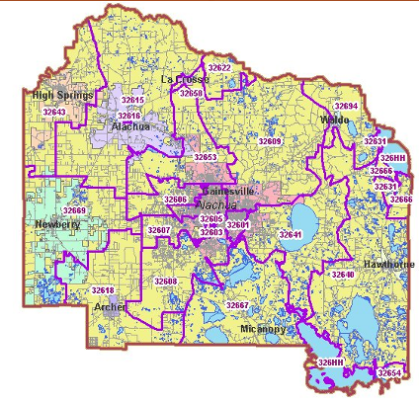
Dense Poverty
Mike Zone
32607 is the 5th most impoverished zip code in the County.
100% of the residents living in Majestic Oaks have an annual income below $10,000.
Zip Code | Residents with income lower than the poverty level (2007) | Residents with income below 50% of the poverty level (2007) | City
32603 | 65.3 % | 53.0 % | Gainesville
32601 | 55.9 % | 41.0 % | Gainesville
32608 | 52.2 % | 40.9 % | Gainesville
32641 | 41.4 % | 28.1 % | Gainesville
32607 | 36.6 % | 26.9 % | Gainesville

Slide 25
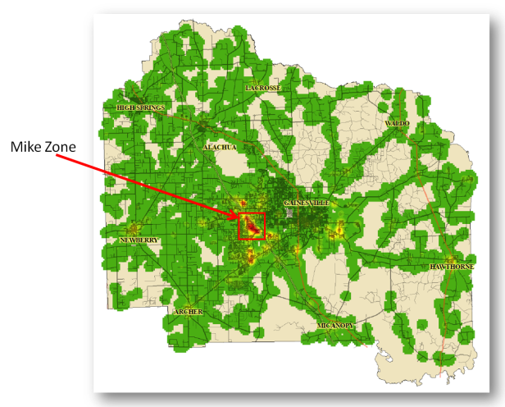
Crime
The Alachua County Sheriff’s Office divides the County into zones based on the area’s call load.
The zone with the highest call load is named Mike Zone.
This zone is just over one square mile and is located in zip code 32607.
The main types of crime in this area are domestic violence, burglary, and assault/battery.
This is a density map indicating crime reports. Green indicates the lowest density, red indicates the highest density.

Slide 26
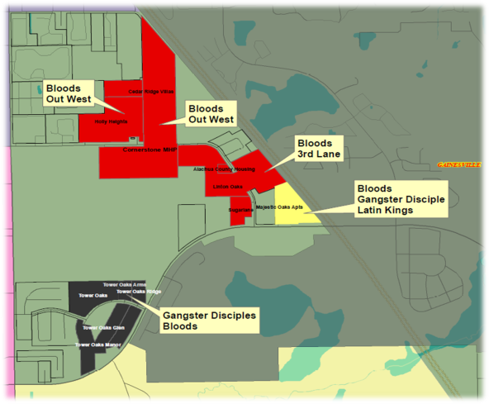
Gangs
This area consists of both national and hybrid gangs:
3RD Lane
Hybrid gang, juvenile members, Linton Oaks
Outwest
Hybrid gang, juvenile members, Holly Heights/ Gordon Manor, Cornerstone MHP
Bloods
National gang, juveniles and adult members, Linton Oaks, Holy Heights/ Gordon Manor, Majestic Oaks, Corner Stone MHP, Tower Oaks
Gangster Disciples
National gang, juvenile and adult members, Tower Oaks, Majestic Oaks
Latin Kings
National gang, adult members, Majestic Oaks

Slide 27
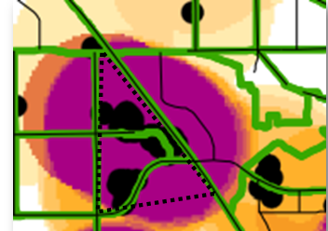
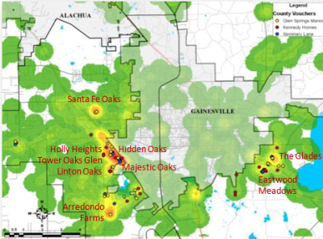
Housing Issues
Density of Code Violations
Project-based, income-based housing
Majestic Oaks
Section 8 rentals
Linton Oaks
Tower Oaks
Holly/Heights/Gordon Manor
Harbor Cove
Hidden Oaks
Individually owned buildings/apartments
Linton Oaks
Tower Oaks
Holly Heights/Gordon Manor
Apartment complexes
Tower Oaks Glen
Harbor Cove
Mobile Homes
Hidden Oaks
Holly Heights/Gordon Manor
Majestic Oaks
Linton Oaks
Tower Oaks
Light Orange indicates the lowest density, Black indicates the highest density.
Dots represent displacement of vouchers into the unincorporated area of the County.
Density indicates crime levels, with red being the highest density.

Slide 28
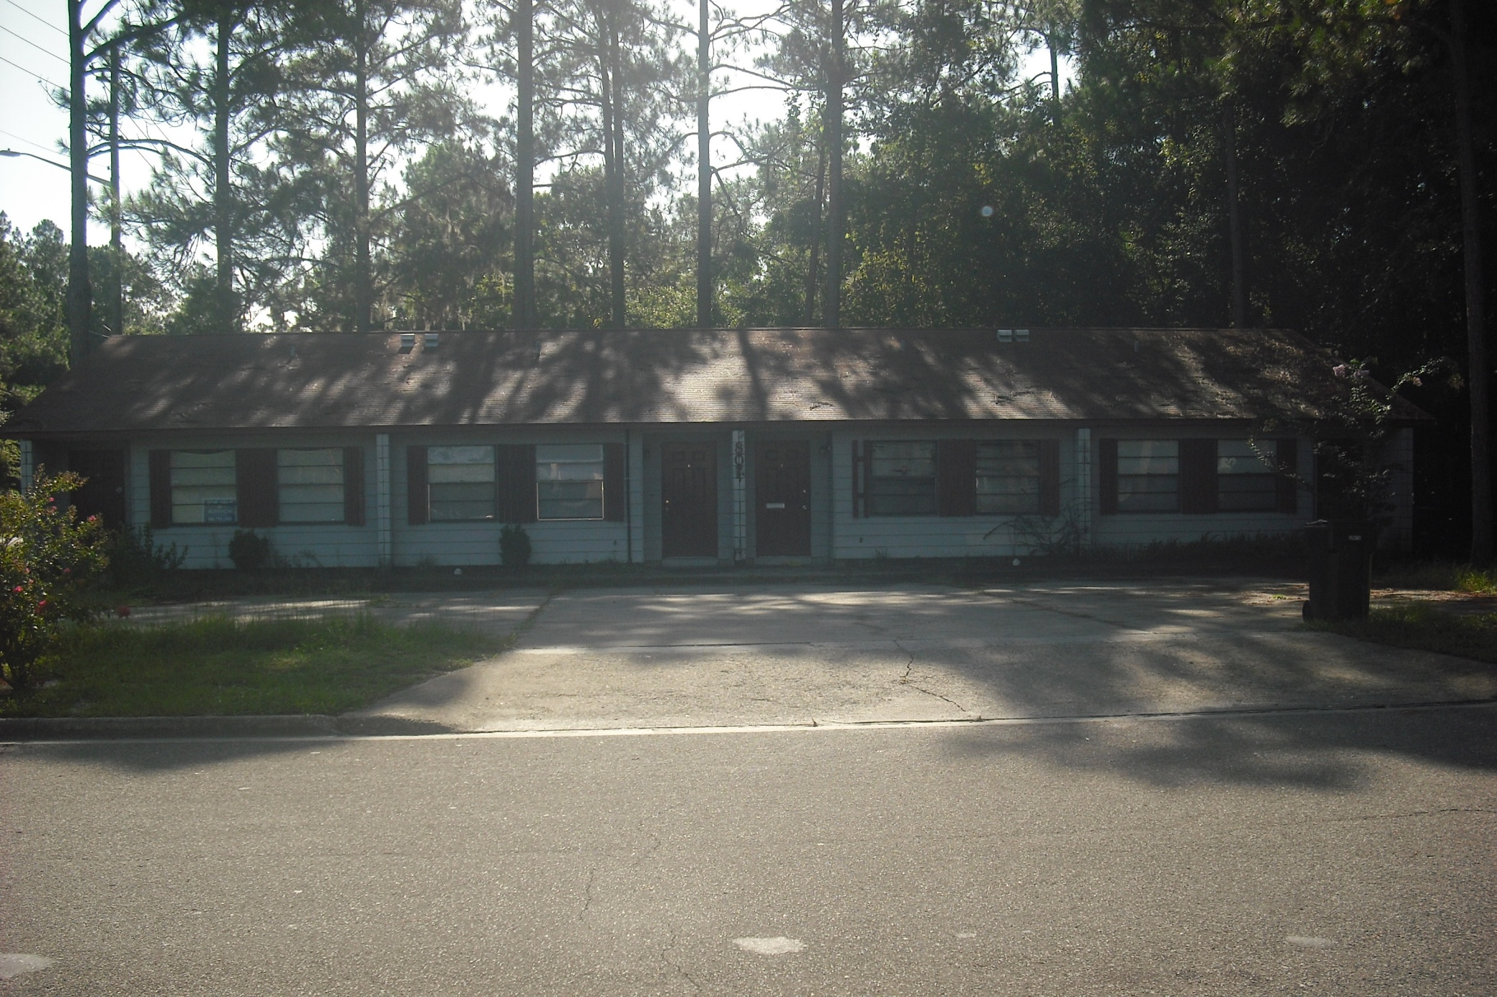
Future Home of the SWAG Family Resource Center

Slide 29
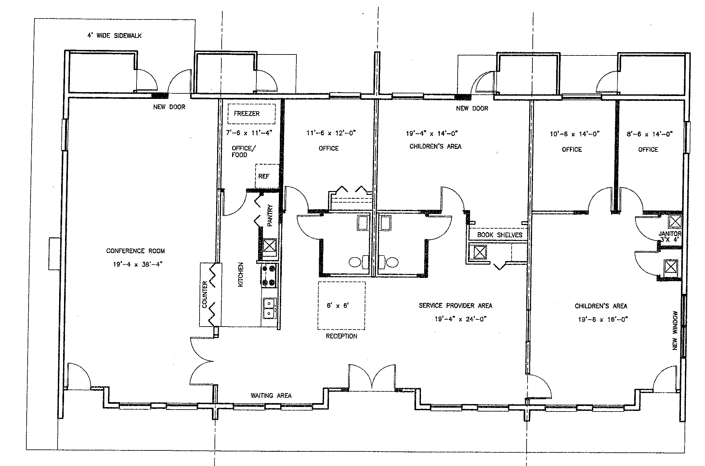
SWAG Family Resource Center Layout

Slide 30
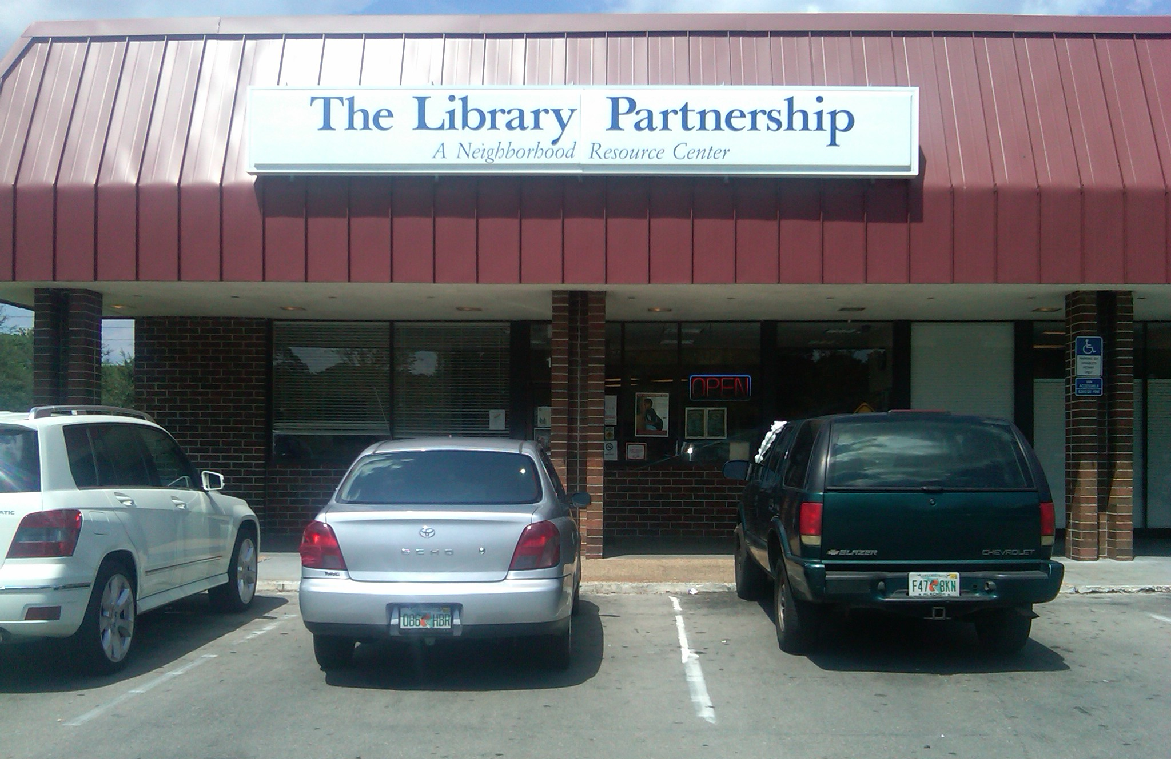
Building on What Works:
The Library Partnership in NE Gainesville
Notes:
S

Slide 31
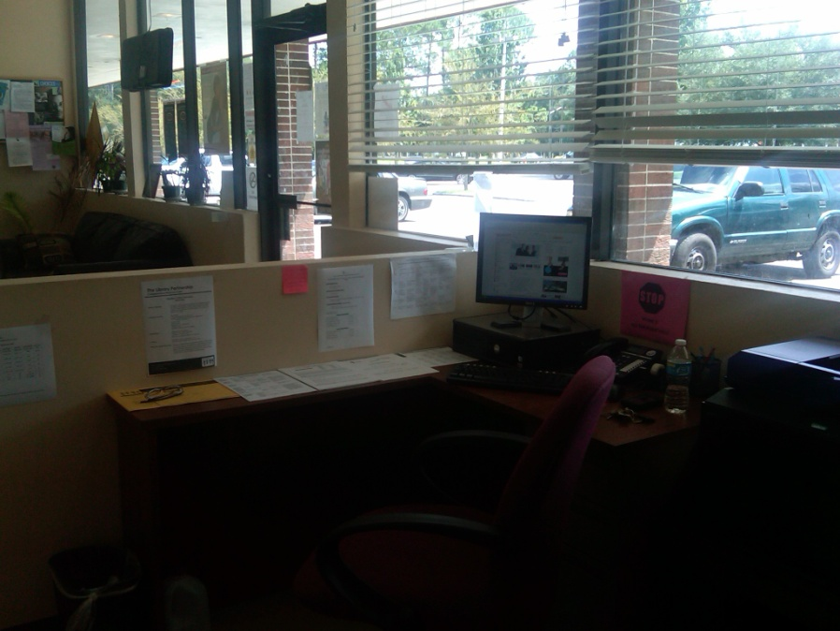
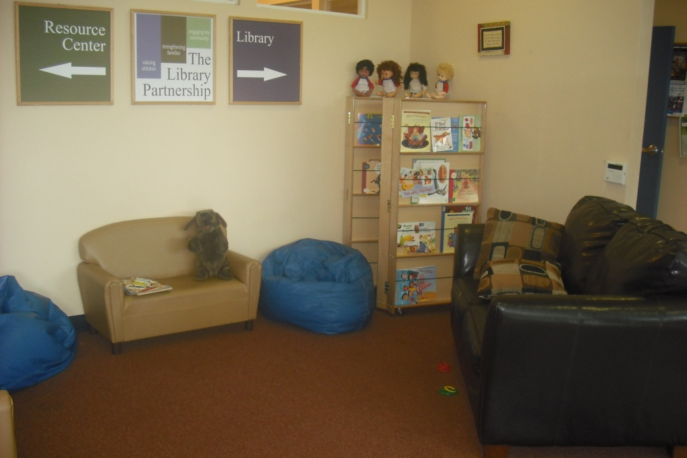
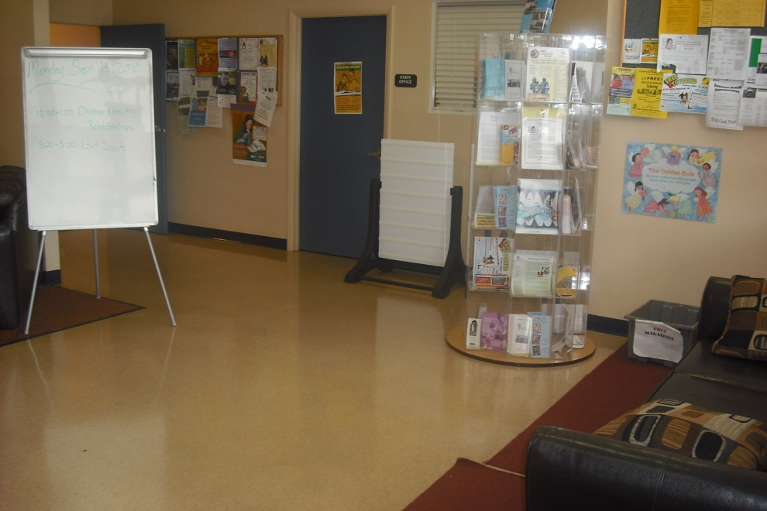
Entrance and Lobby

Slide 32
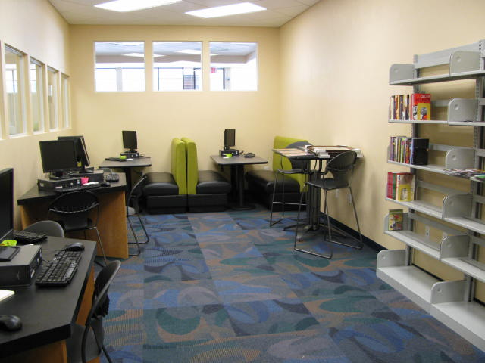
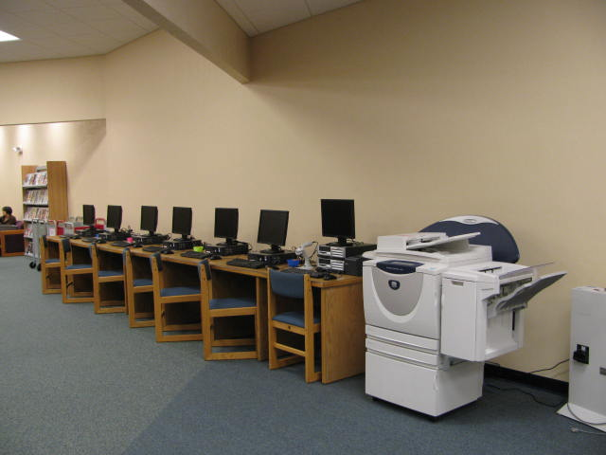
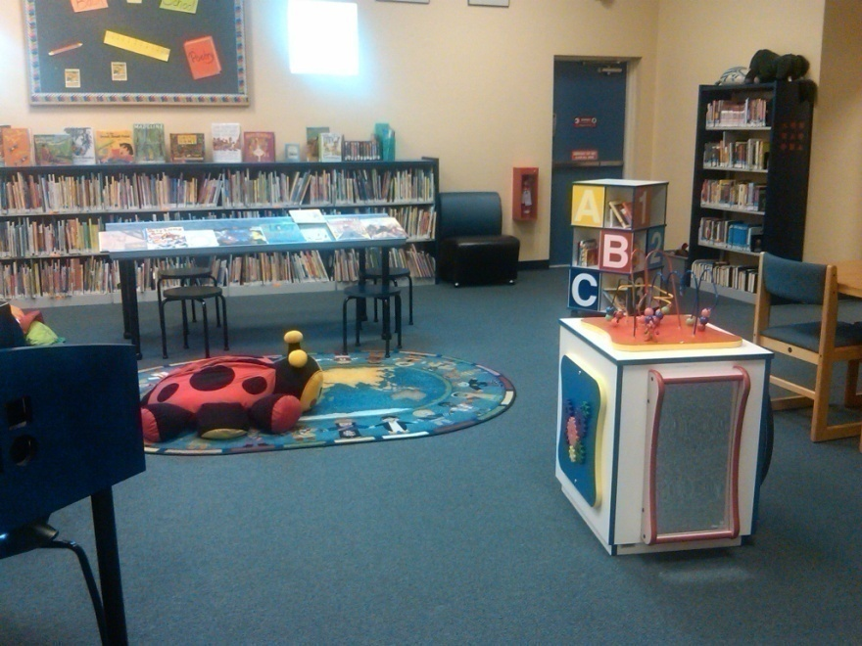
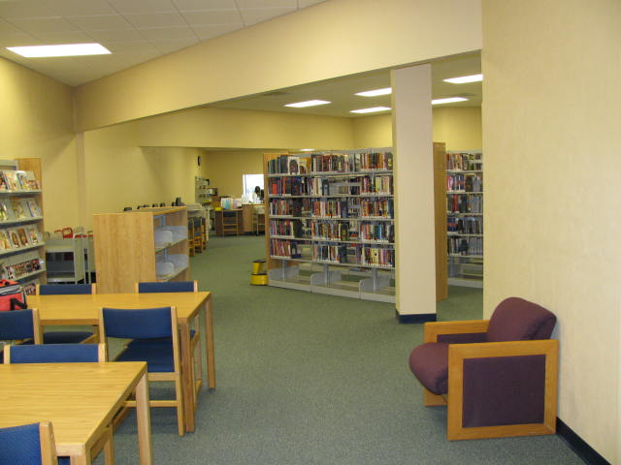
Spaces for Adults, Teens, and Young Children

Slide 33
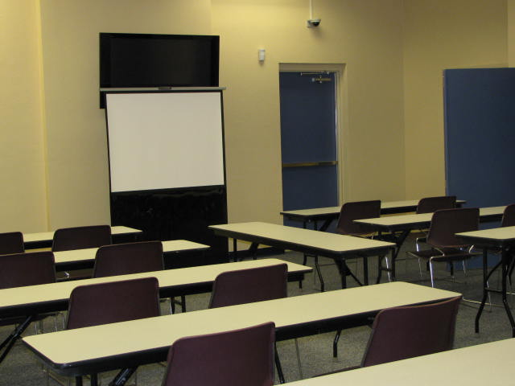
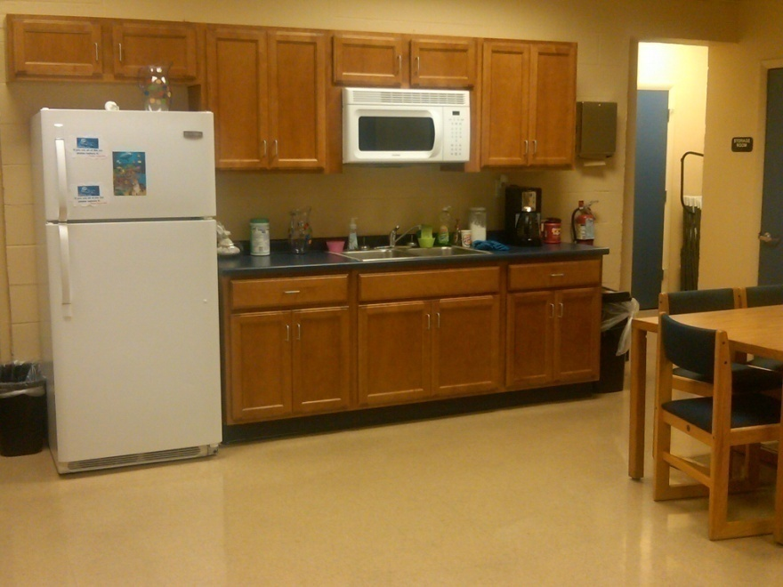
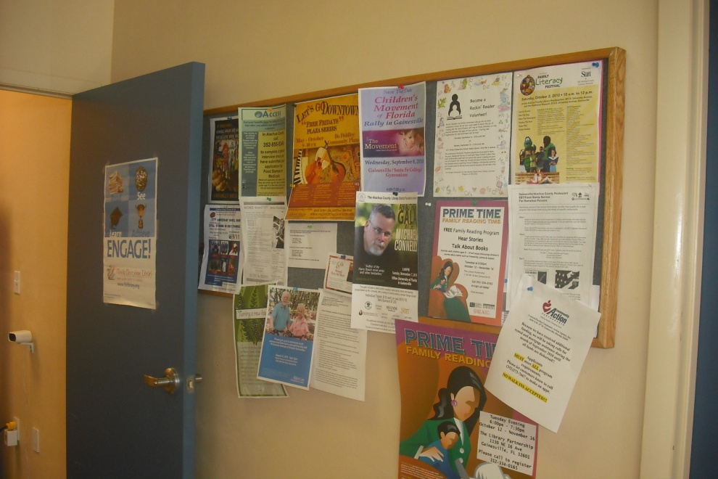
Community Spaces

Slide 34
Strengthening Families Approach
The 5 Protective Factors:
Parental Resilience
Social Connections
Concrete Support in Times of Need
Knowledge of Parenting and Child Development
Social and Emotional Competence of Children
Notes:
Five Protective Factors are the foundation of the Strengthening Families Approach. Research studies support the common-sense notion that when these Protective Factors are well established in a family, the likelihood of child abuse and neglect diminishes. Research shows that these protective factors are also “promotive” factors that build family strengths and a family environment that promotes optimal child and youth development.
Families thrive when protective factors are robust in their lives and communities. Strengthening Families is a research-based, cost-effective strategy to in­crease family strengths, enhance child development and reduce child abuse and neglect. It focuses on building five Protective Factors that also promote healthy outcomes.
• Benefits ALL families.
• Builds on family strengths, buffers risk, and promotes better outcomes.
• Builds on and can be integrated into existing programs, strategies, systems and community opportunities.
• Can be implemented through small but significant changes in everyday actions.
• Is grounded in research, practice and implementation knowledge.

Slide 35
America’s Promise Alliance
The 5 Promises:
Caring Adults
Safe Places
A Healthy Start
Effective Education
Opportunities to Help Others
Notes:
The Five Promises are those developmental resources — wrap-around supports — that young people need for success in life. Everything we do as an Alliance is built around the framework of ensuring that more young people experience more of the Promises.
Children who receive at least four of the Five Promises are much more likely than those who experience only one or zero Promises to succeed academically, socially and civically. They are more likely to avoid violence, contribute to their communities and achieve high grades in school.
Receiving at least four of the Five Promises also appears to mitigate gaps across racial and economic boundaries. To experience the full power of the Promises, young people must experience these critical supports throughout their lives — in their families, at schools and out in their communities.

Slide 36
SWAG Family Resource Center
Partners providing services to facilitate the 5 Protective Factors and 5 Promises.
Working toward a continuum of care for families.
Utilizing the Library Partnership’s “Getting to Know You” form to identify need for services.
Creating a service plan to address needs.
Follow-up to assess process.

Slide 37
Assess community’s needs and assets
Structure SFRC around 5 Protective Factors and 5 Promises to address needs
Residents access SFRC and complete “Getting to Know You” form
Resident’s Protective Factors and Promises are assessed/needs paired with provider services
Maintain relationship with resident and encourage their participation in their community
Create service plan and follow-up with resident and providers
Concrete Support
in Times of Need
Social Connections
A Healthy Start
Knowledge of Parenting
and Child Development
Safe Places
Effective Education
Parental
Resilience
Caring
Adults
Social and Emotional
Competence of Children
Opportunities to
Help Others
5
Protective
Factors
5
Promises

Slide 38
Example Framework for Assessment, Service Planning, and Follow-Up
Additional concerns identified after discussing Patron’s initial reason for visiting the SFRC
Opportunities for strengthening family identified after assessment of Protective Factors and Promises
SWAG Family Resource Center Patron
Identifies need for utility assistance
Unemployed
Needs assistance with budgeting
Identifies need for tutoring for child
Illiterate
Parental Resilience
Concrete Support in Times of Need
Effective Education
Initial conversation with Patron
Related to Parent’s Protective Factors
Related to Promises for Child

Slide 39
Partners who can provide services to address identified Protective Factors and Promise opportunities for improvement
Patron goals developed out of contact with service providers
Opportunities for strengthening family identified after assessment of Protective Factors and Promises
Parental Resilience
Concrete Support in Times of Need
Effective Education
Florida Works' Reemployment and Eligibility Assessment (REA program)
Catholic Charities' Step Forward program
UF HEROES' NaviGator to provide tutoring and assist parent with access to child's teachers and school
Gap in services identified: adult literacy resources
Earn GED
Get computer skills training
Find opportunities to volunteer in the community and gain experience
Earn a job that provides income to pay expenses
Reduce expenses by sharing resources with others in the community
Meet child's teachers every year and contact them regularly for updates
Regularly discuss school progress with child
Read with child nightly
Service Plan created incorporating goals and partners committed to providing services
Follow-up with families to ensure family’s progress and success
Encourage family to participate in upcoming community events
Research community resources to bring an adult literacy specialist to the resource center

Slide 40
SWAG Family Resource Center Management Structure
Resource Center Manager "DeleGator"
CongreGator Coordinator
Event Planning
Networking
NaviGator Coordinator
Daily Operations
Partnership for Strong Families
Graduate Students
SWAG Members
Service Providers
Undergraduate & Graduate Students
SWAG Members
Adult Residents & Youth
Programming
InvestiGatorCoordinator
Data Collection
Resident recruitment, health/ safety fairs, seminars, meetings
Service provider recruitment, partnerships with local agencies and organizations
Greet patrons, Resource Center tours, service plans, follow-up, respond to questions, address concerns
Assist service providers as needed, provide qualified programming, schedule programming, maintain programming data
Community research, student projects, needs/assets assessments, organize Resource Center usage data
SWAG Board

Slide 41
Continuing Community Building using Photovoice
Patron goals developed out of contact with service providers
Partners who can provide services to address identified Protective Factors and Promise opportunities for improvement
Opportunities for strengthening family identified after assessment of Protective Factors and Promises
Parental Resilience
Concrete Support in Times of Need
Effective Education
Florida Works' Reemployment and Eligibility Assessment (REA program)
Catholic Charities' Step Forward program
UF HEROES' NaviGator to provide tutoring and assist parent with access to child's teachers and school
Gap in services identified: adult literacy resources
Earn GED
Get computer skills training
Find opportunities to volunteer in the community
Earn a job that provides income to pay expenses
Reduce expenses by sharing resource with others in the community
Meet child's teachers every year and contact them regularly for updates
Regularly discuss school progress with child
Read with child nightly
A tool for community engagement and collective action
Initial project:
SWAG Family Resource Center focus group
Open house event for the community
Discuss resource center history
SWAG, advocacy, and success
Discuss resource center purpose
Community development
Service provision
Discuss resource center future
Photovoice
Service Plan created incorporating goals and partners committed to providing services
Follow-up with families to ensure family’s progress and success

Slide 42
Photovoice
Patron goals developed out of contact with service providers
Partners who can provide services to address identified Protective Factors and Promise opportunities for improvement
Opportunities for strengthening family identified after assessment of Protective Factors and Promises
Parental Resilience
Concrete Support in Times of Need
Effective Education
Florida Works' Reemployment and Eligibility Assessment (REA program)
Catholic Charities' Step Forward program
UF HEROES' NaviGator to provide tutoring and assist parent with access to child's teachers and school
Gap in services identified: adult literacy resources
Earn GED
Get computer skills training
Find opportunities to volunteer in the community
Earn a job that provides income to pay expenses
Reduce expenses by sharing resource with others in the community
Meet child's teachers every year and contact them regularly for updates
Regularly discuss school progress with child
Read with child nightly
Project outline
Identify community issue of interest
Identify resident facilitator
Define goals and objectives for project
Recruit residents to participate
Develop a schedule/timeline
Take photos
Develop photos
Discuss photos
Identify action goal
Identify action schedule/timeline
Evaluate action and act again/continue acting or proceed in a different way
Service Plan created incorporating goals and partners committed to providing services
Follow-up with families to ensure family’s progress and success

Slide 43
Photovoice
Patron goals developed out of contact with service providers
Partners who can provide services to address identified Protective Factors and Promise opportunities for improvement
Opportunities for strengthening family identified after assessment of Protective Factors and Promises
Parental Resilience
Concrete Support in Times of Need
Effective Education
Florida Works' Reemployment and Eligibility Assessment (REA program)
Catholic Charities' Step Forward program
UF HEROES' NaviGator to provide tutoring and assist parent with access to child's teachers and school
Gap in services identified: adult literacy resources
Earn GED
Get computer skills training
Find opportunities to volunteer in the community
Earn a job that provides income to pay expenses
Reduce expenses by sharing resource with others in the community
Meet child's teachers every year and contact them regularly for updates
Regularly discuss school progress with child
Read with child nightly
Project presentation and next steps
Present Photovoice project at SWAG monthly potluck
Discuss projects
Provide updates
Recruit residents to participate
Display projects in the SWAG Family Resource Center
Service Plan created incorporating goals and partners committed to providing services
Follow-up with families to ensure family’s progress and success

Slide 44
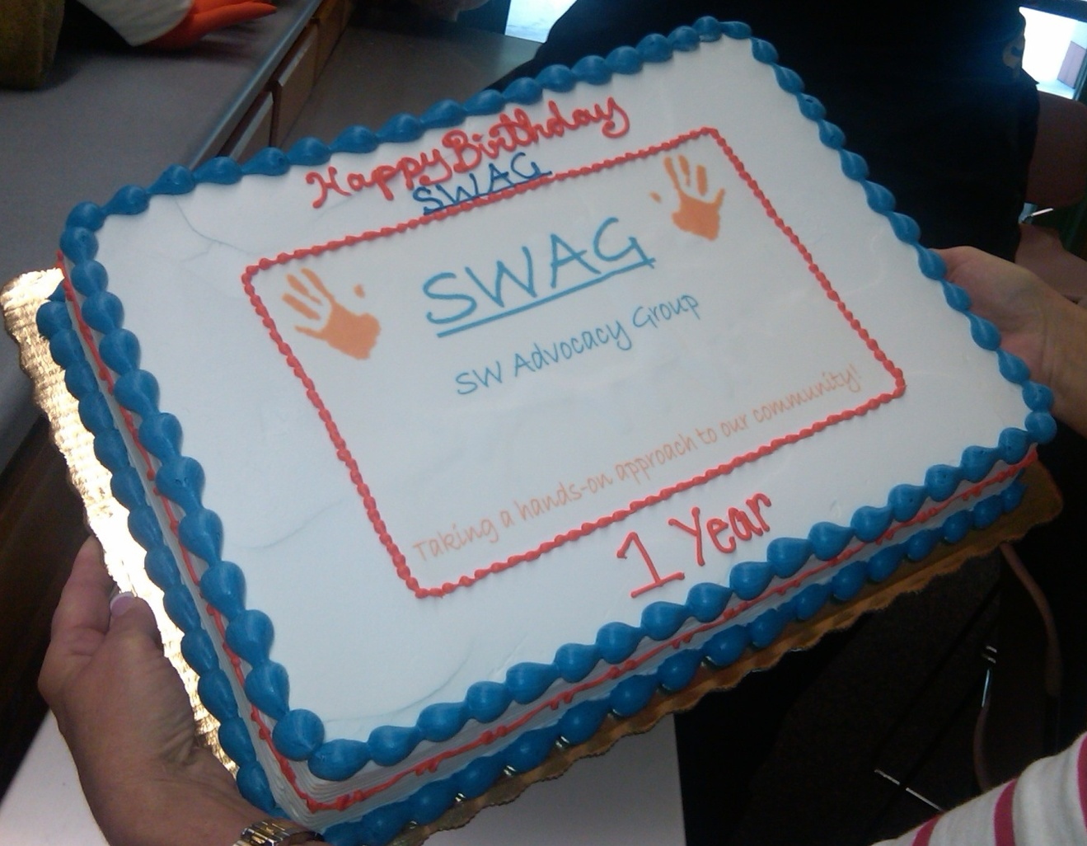
SWAG
Patron goals developed out of contact with service providers
Partners who can provide services to address identified Protective Factors and Promise opportunities for improvement
Opportunities for strengthening family identified after assessment of Protective Factors and Promises
Parental Resilience
Concrete Support in Times of Need
Effective Education
Florida Works' Reemployment and Eligibility Assessment (REA program)
Catholic Charities' Step Forward program
UF HEROES' NaviGator to provide tutoring and assist parent with access to child's teachers and school
Gap in services identified: adult literacy resources
Earn GED
Get computer skills training
Find opportunities to volunteer in the community
Earn a job that provides income to pay expenses
Reduce expenses by sharing resource with others in the community
Meet child's teachers every year and contact them regularly for updates
Regularly discuss school progress with child
Read with child nightly
Service Plan created incorporating goals and partners committed to providing services
Follow-up with families to ensure family’s progress and success
“When it comes right down to it, we’re a group that decided to trust each other.”
~Dorothy Benson, SWAG Chair

Slide 45
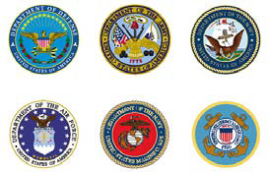
Thank you to SWAG’s Partners Our partnerships have made this project a success!
Platinum Partners
Golden Partners
Partners for a Productive Community
Silver Partners
Skinner, Vignola, McLean, Inc.
CH2M Hill
Veterans Advisory Board
Members

