Slide 1
AAHRPP + IRB Update
Michael Mahoney
Director of Research Operations and Services
mmahoney@ufl.edu

Slide 2
 | What is AAHRPP?
Association for the Accreditation of Human Research Protection Programs.
Mission:
Protect the rights and welfare of research participants
Promote excellent and ethically sound research by accrediting high quality human research protection programs

Slide 3
 | Who is Accredited?
231 entities are AAHRPP accredited worldwide
60% universities & 65% medical schools
NIH and Pfizer are AAHRPP accredited
10 entities in Florida accredited, including:
University of Miami
University of South Florida
University of Central Florida
Florida Department of Health

Slide 4
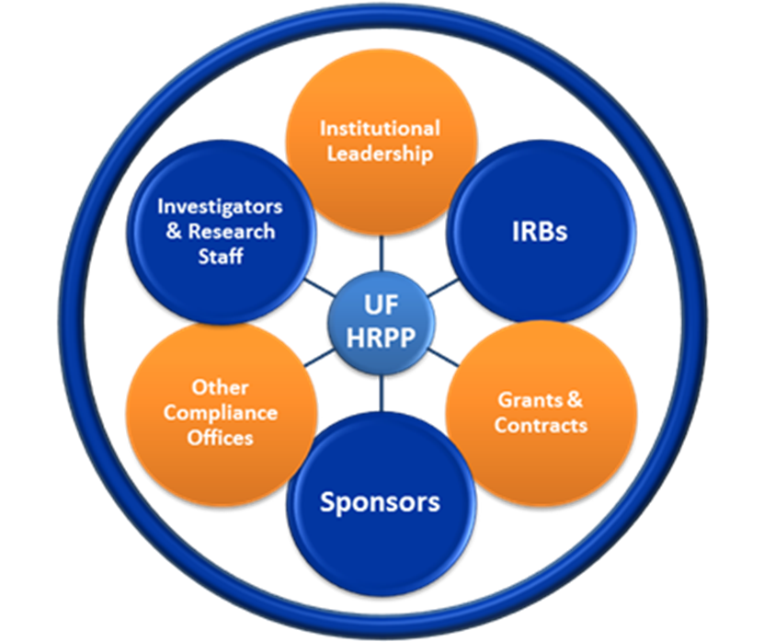
 | Impact of AAHRPP?
More formalized HRPP
Better defined Structure, Process, & Outcome
More monitoring

Slide 5
 | Notable AAHRPP Changes
Required training
Vulnerable Subjects
Reviewer responsibilities
New Policies & Guidelines
Evaluation of IRB members
Contract language

Slide 6
 | Contract additions
Sponsors must promptly report info that could
Affect subject safety
Influence conduct of study
Sponsors must DSMB reports to UF (with timeframe)
Sponsor must follow UF P&P for publishing data

Slide 7
 | Deficiencies noted
Unanticipated Problems
Unexpected; Related to the protocol; New or increased risks to subjects or others
Guideline: Unanticipated Problems Involving Risks to Subjects or Others
Consenting subjects who don’t speak/read English
Translated consent for targeted populations
IRB Short form process (translator alone is insufficient)
Guideline: Obtaining and Documenting Informed Consent of Subjects Who Do Not Speak or Read English

Slide 8
 | What else is new?
Post Approval Survey
Metrics
No Response Reminder
International Form
Other tools

Slide 9
 | Post Approval Survey
Initiated May 2017
UF Qualtrics survey (QI, not research)
myIRB emails link to study team after new study is approved
5 questions:
Which IRB?
Rate our service: staff, reviewers, myIRB, timeliness of review
Problems / suggestions for improvement (open text)
Positive experiences (open text)
Anonymous, but can choose to provide contact info if we have questions

Slide 10
 | Post Approval Survey
Real time review:
Director Research Operations
Asst Director of IRBs
IRB Chair
Promptly
Thank respondent if identified
Address issues
Acknowledge recognized staff or reviewers

Slide 11
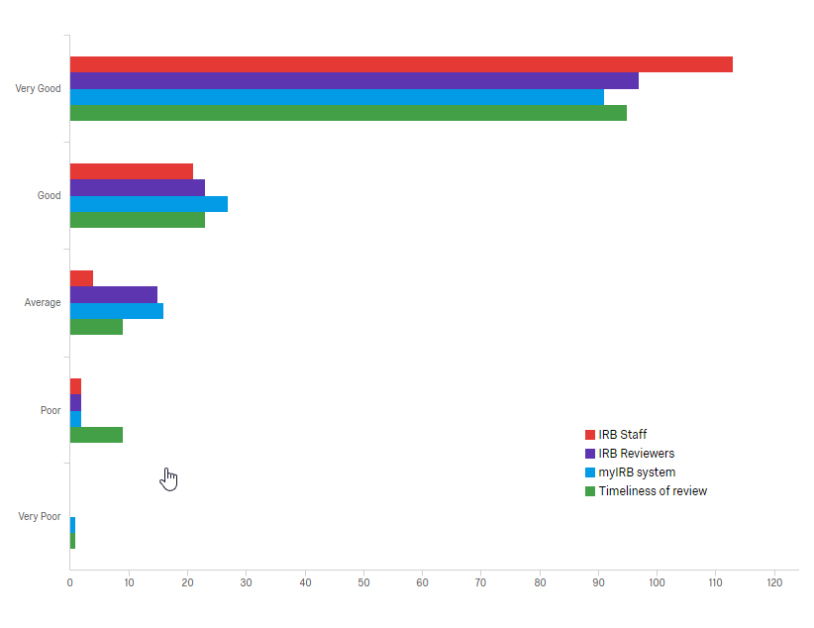
 | Post Approval Survey
443 responses to date
Monthly +annual reports for each IRB:
IRB Chairs and Staff
VP for Research
Share with ADRs
Goal: publish on IRB website

Slide 12
 | Metrics: New Studies

Slide 13
 | Metrics: New Studies

Slide 14
 | Metrics: No Response > 60 days
myIRB upgraded to send reminders to study teams
New studies: 30, 60, and 90 days
CRs: 15, 30, and 60
Revisions: 15, 30, 60
Reportable Events: 7, 15, 30

Slide 15
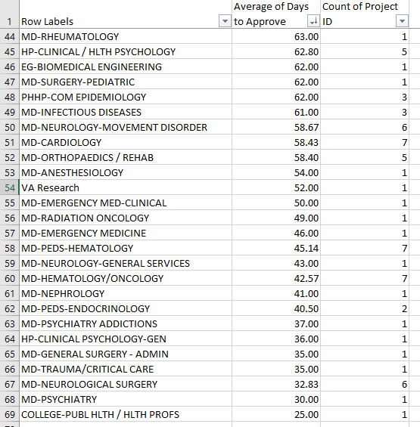
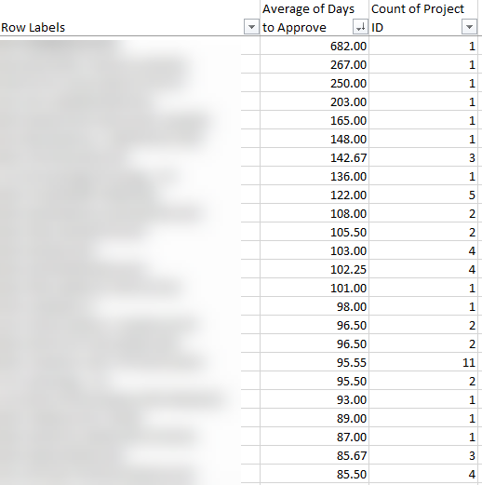
 | Metrics: Departments (Full Board)

Slide 16
 | Metrics: Departments (Full Board)
Average of Days to Approve | IRB Staff | Reviewer | Meeting | Study Staff
682.00 | 25.62 | 10.45 | 42.47 | 602.49
267.00 | 6.51 | 14.61 | 12.67 | 229.21
250.00 | 32.63 | 8.13 | 14.5 | 193.73
203.00 | 24.65 | 2.79 | 54.72 | 121.01
165.00 | 19.33 | 18.01 | 40.02 | 86.78

Slide 17
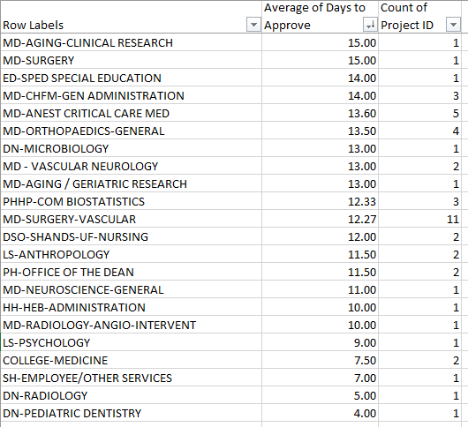
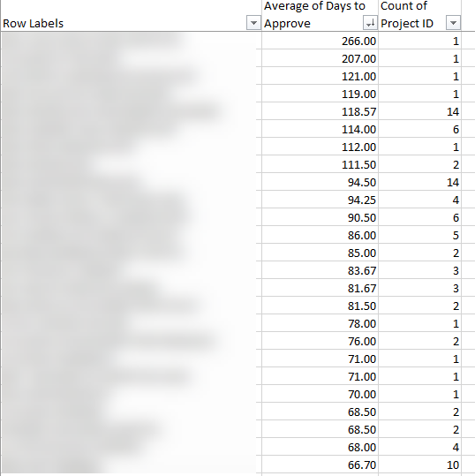
 | Metrics: Departments (Expedited)

Slide 18
 | International Research
Tool: International Research Involving Human Subjects
Purpose:
Help PI identify additional regulatory requirements
Help direct PI to other UF resources (e.g. UFIC)
Provide institution the information to address non-IRB compliance issues (e.g. IT Security, Export Control, etc).
Fill out and click “submit” to send for Office of Research review
Processed in parallel to IRB, so submit to IRB when ready

Slide 19
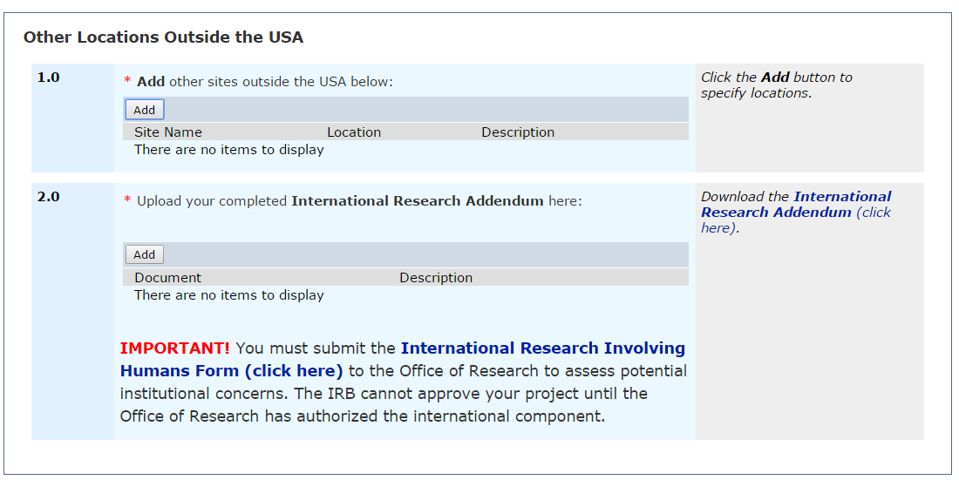
 | International Research
title

Slide 20
 | Other tools
Research Portal
http://research.ufl.edu/researchportal/
Research Training Utility
http://research.ufl.edu/rtu.html
New PI form
http://research.ufl.edu/forms/newresearcher.html
Leaving PI form
http://research.ufl.edu/forms/notification-of-departing-pi.html

