Slide 1
Strategy Lunch and Learn #1
Early Career Opportunities and Signature Programs
Gail Fish
Ashley Ray, PhD
January 29, 2026

Slide 2
Strategy Lunch and Learn Series
1. Early Career Programs | January 29
2. Maintaining Momentum | February 26
3. Writing Proposals | March 26
4. Whitepapers | April 16
5. Slow Funding Periods | May 14

Slide 3

Housekeeping
Low stakes learning environment
Please be engaged during the activities
We want to hear from YOU!

Slide 4







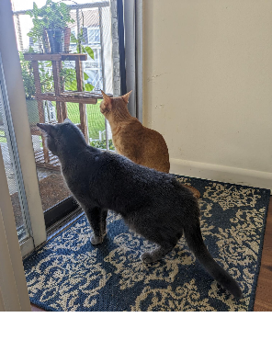
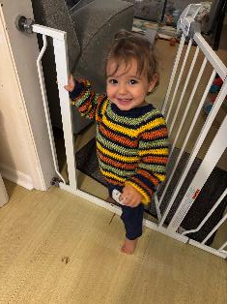
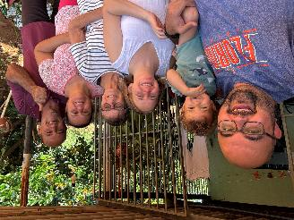

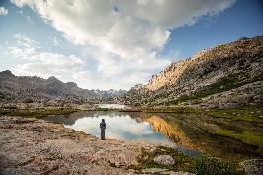
People Spotlight: Gail Fish

Slide 5



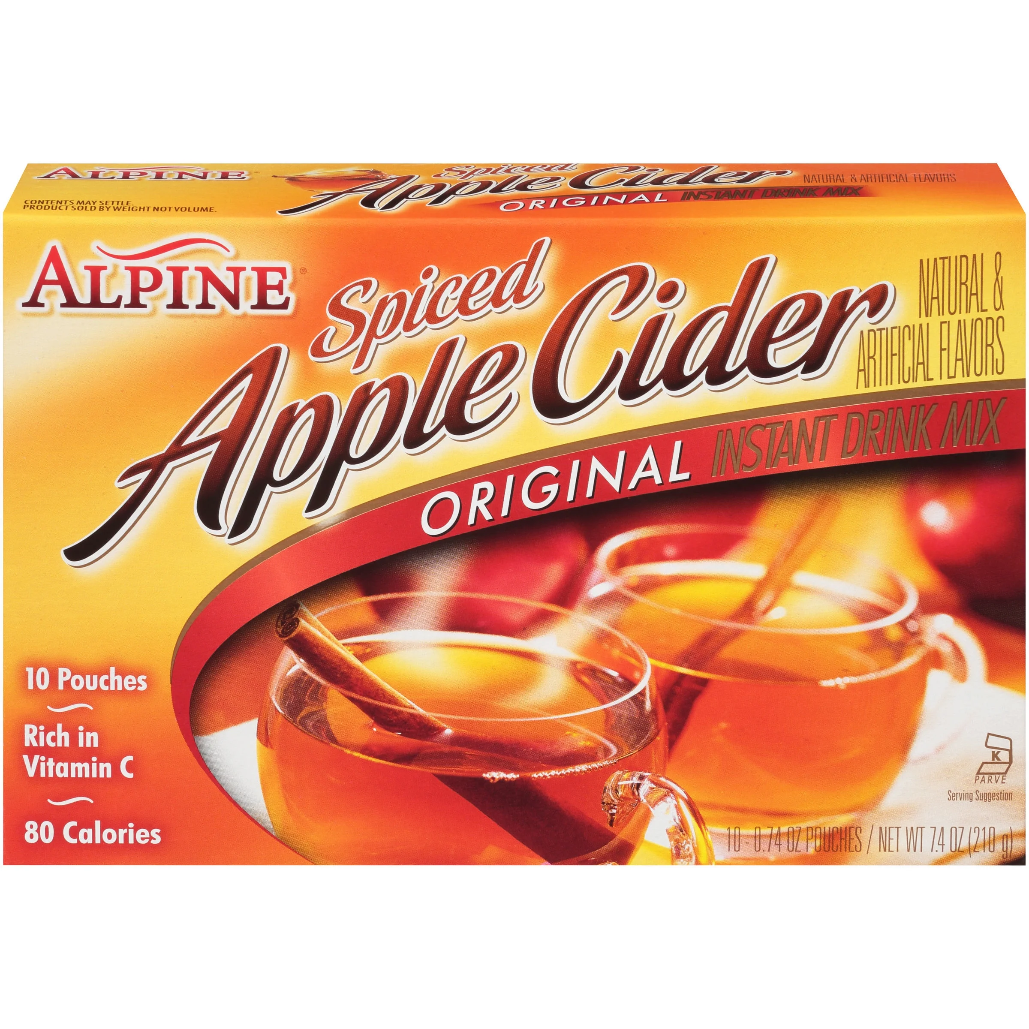
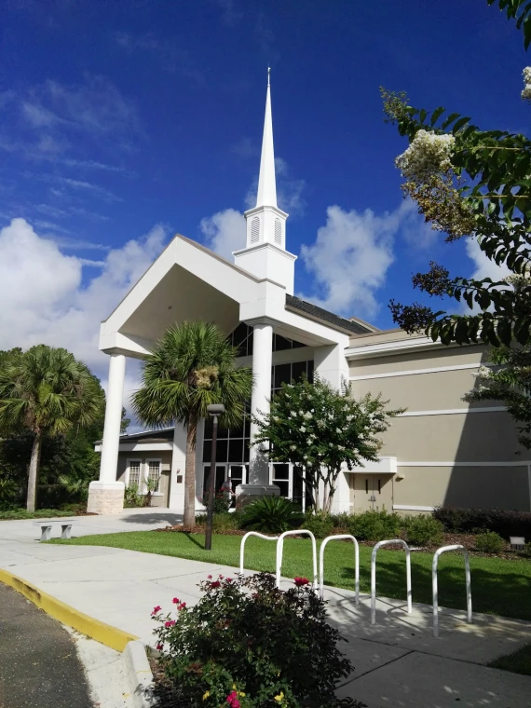
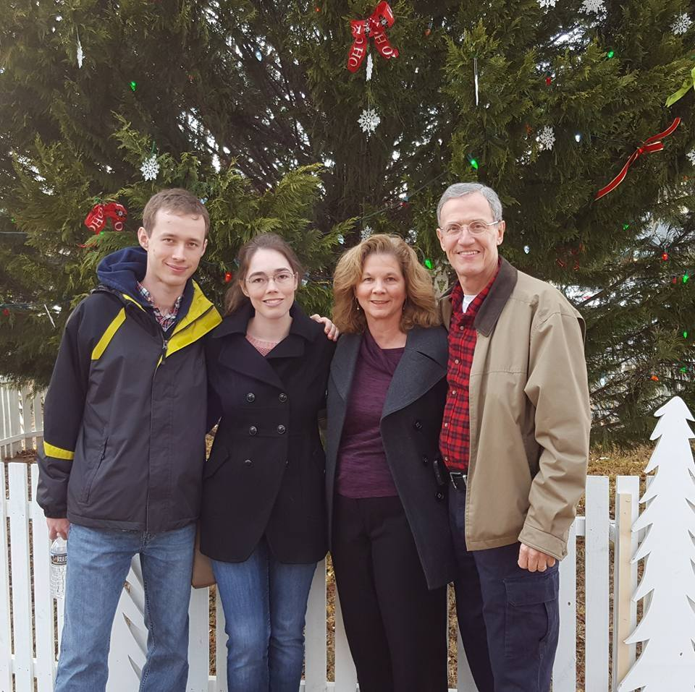
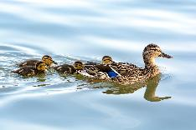


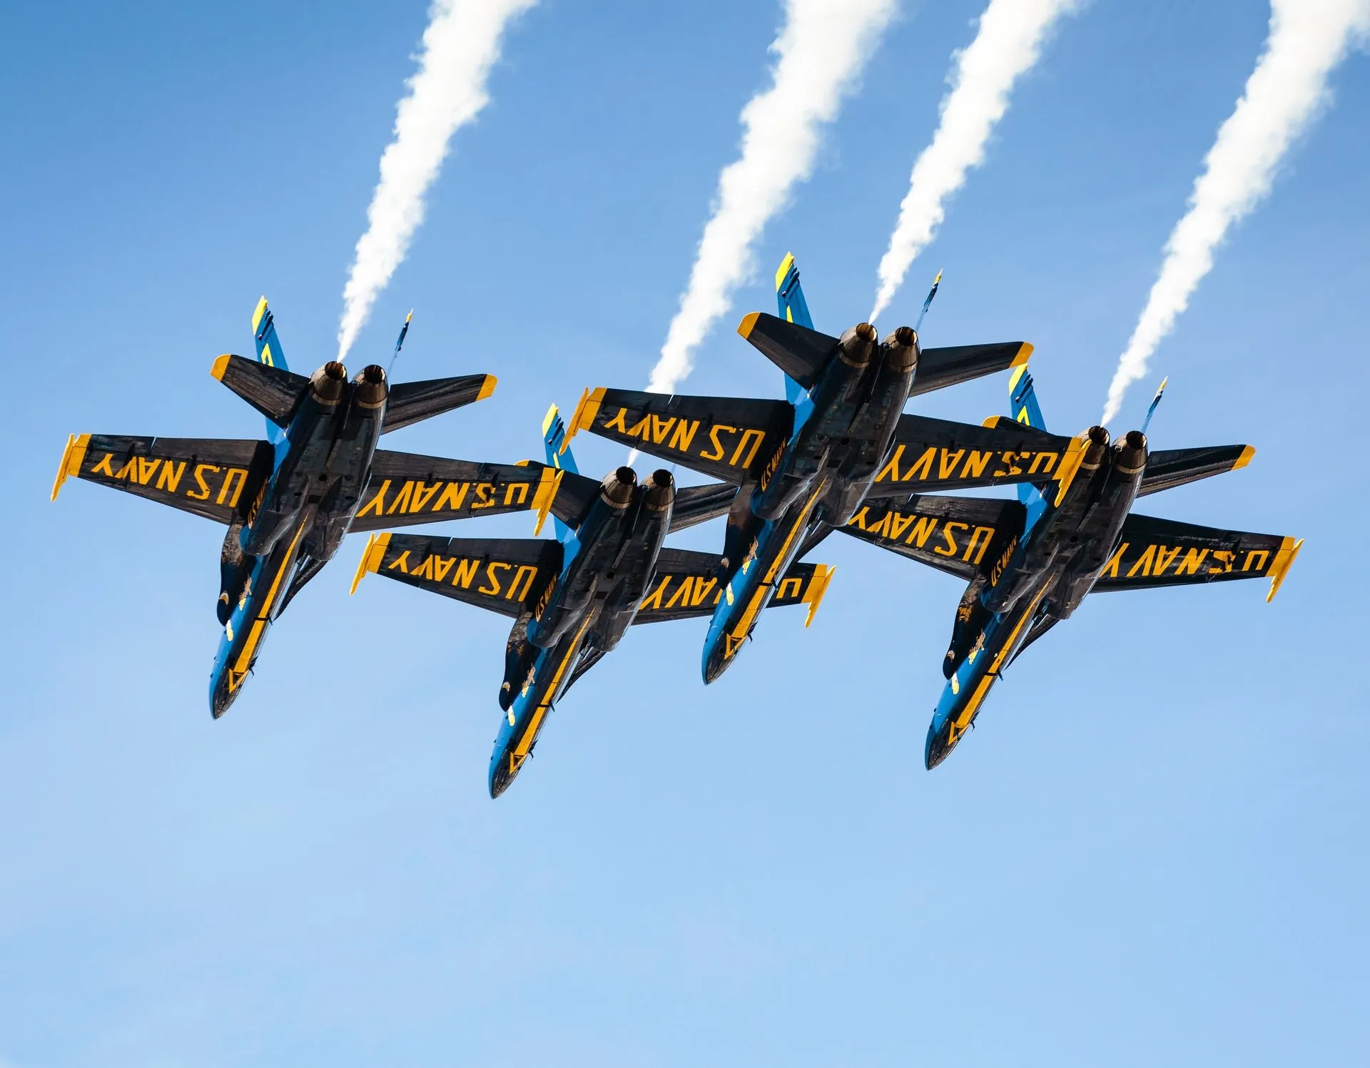

People Spotlight: Ashley Ray, PhD

Slide 6

Early Career Programs
Early Career Opportunities
Often prestigious
Usually multi-year
Federal and non-Federal
  Broad vs Narrow (usually)
Fellowships
Notes:
Examples of Foundations:
McKnight Foundation Scholar Awards- neuroscience
Burroughs Wellcome Fund- Career Award for Medical Scientists (physician-scientists)

Slide 7

Poll time!
Zoom Poll: Experience with Early Career Programs?
Polling
#1 No experience
#2 Looked at programs or started applications
#3 Applied and am waiting on a response/ was not selected
#4 Applied and was awarded

Slide 8
Funder | Name | Due | Preproposal Required | Amount Funded
NSF | CAREER | July | No | $500k/5 years
DOE | Office of Science Early Career Research Program | April | Yes (due Feb) | $875k/5 years
AFOSR | Young Investigator Program | Sept | Whitepaper (July) | $450k/3 years
ARO | Early Career Program | Rolling | No | $360k/3 years
DARPA | Young Faculty Award | Feb | No, exec summary ‘strongly encouraged’ (Nov) | $500k/2 years
ONR | Young Investigator Program | Aug | No | $750k/3 years
NIH | K Awards (mentored) | Varies | Check each Opp | Varies, 3-5 years
Notes:
Check website for exact eligibility! Usually tenure-track but untenured and within several years of PhD receipt.
ARO: Army Research Office
AFOSR: Air Force Office of Scientific Research

Slide 9


Early Career Programs: Myth and Fact
Myth: An early-career award is easier to win than a 'regular' award because fewer people are eligible to apply.
Fact: Early career awards are very competitive with a high share of eligible PIs applying.

Slide 10
Early Career Programs: Myth and Fact
Myth: Materials outside the main narrative (e.g., obtaining a chair letter) do not need much lead time or work.
Fact: Chair letters are often scrutinized closely and can take a long time to get. Make the request early.

Slide 11
Early Career Programs: Myth and Fact
Myth: Early career program awards are the only thing you should focus on within an agency at this stage.
Fact: Conversations with Program Officers/Managers are worth the effort. They can alert you to current or upcoming programs aligning with your research and career goals.
Notes:
e.g. Smaller seed funding more appropriate; collaborative proposals as Co-PI; more targeted research areas where you even as early career may be competitive.

Slide 12
Early Career Programs: Myth and Fact
Myth: Since most programs are recurring, eligibility requirements and dates will not change year-to-year.
Fact: Eligibility, requirements and dates do change– especially under a new administration. Check regularly!
Notes:
e.g., IES had a great 3-year Early Career Development and Mentoring Program for Education Research program. But the entire scope of IES is still in question.

Slide 13
Strategies for Early Career Programs
Notes:
High level. Individual programs are worth looking into.

Slide 14

Get feedback on your proposal.
Early and often.
Internal Review
Notes:
Multiple eyes and angles. Time to refine idea and ensure alignment with program goals and requirements.

Slide 15

Search for recent awardees. They are often requested to review future early career applications.
Previous Winners

Slide 16

For proposals with boarder impacts, connect with partners and other resources.
Collaborators
Notes:
E.g. NSF CAREER has an educational activities section above and beyond teaching requirements at UF. Plug into something like the Center for Precollegiate Education and Training or Thomson Earth Systems Institute or IFAS Extension partners with experience and infrastructure and networks instead of reinventing the wheel.

Slide 17
Learn More on Campus
Early Career Workshop, H.W. College of Engineering
Provost calendar of early career awards
Institute of Food and Agricultural Sciences (only) NSF Career cohort
K12 Career Development awards (Clinical and Translational Science Institute)

Slide 18










YOU + IFAS Office of Research = ALL-IFAS Early CAREER Cohort
Early Career Faculty Commitment
Benefits of Participation
Participate actively in biweekly ALL-IFAS Cohort meetings via ZOOM (approximately 2.5-3 hours per month from March 15 – June 15); Bring Questions, Suggestions, Lessons Learned to share with all of us
Connect with and learn from peer IFAS Early Career Faculty - several of whom have and readily share their firsthand experience gained through previous NSF CAREER proposal submissions
Engage early and often with your Cohort Partner (hours and frequency agreed by you and Partner(s) as needed/accommodates your schedules) to develop/revise your own sections and share timely review and feedback on those of your Partner(s)
Follow a structured timeline to develop and receive feedback (individually from a Cohort partner and in responses to your questions from the full Cohort) on all elements of your NSF CAREER proposal
Communicate with your Department Chair and Pre-Award Research Administrator early and throughout the process of preparing and submitting your CAREER Proposal
Receive guidance on designing Broader Impacts objectives that align with your research alongside support in connecting with UF resources for assistance in realizing and evaluating education and outreach and access-related activities
Prepare a complete CAREER Proposal even if you ultimately choose not to submit in July 2026
Learn from IFAS Faculty with experience as NSF Program Directors and from IFAS and UF Faculty who have obtained the NSF CAREER Award as they share guidance + encouragement and respond to your questions in real time (2 to 3 dedicated meetings with the Cohort)
Adhere to Cohort Agenda and Timeline to allow for Red Team review of your proposal; Adhere to your Departmental Deadline, IFAS Deadline and DSP Deadline for submission of your proposal
All Cohort participants are eligible to request feedback and editing on proposal elements throughout the March – June timeline; and participants who share a submission-ready proposal in mid-June are eligible for Red Team review of the proposal by UF Faculty
For Additional Information and to Join the Cohort, Contact Christine Frank: cafrank@ufl.edu

Slide 19

Whiteboard activity
Share your top tips for preparing for an early career award.
Share something you plan to do THIS WEEK for early career award preparation.

Slide 20

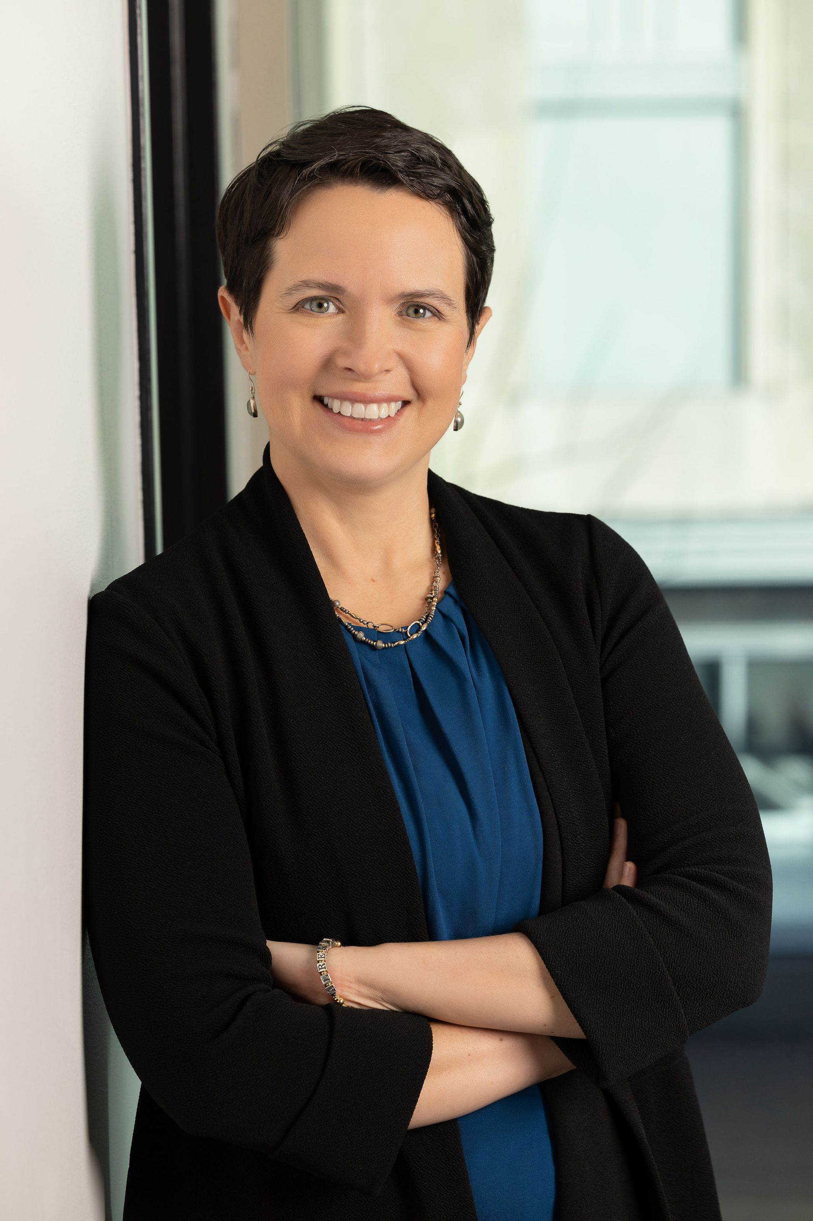
Information
Founded by Julia Barzyk, PhD, former Army Research Office Program Manager
Free resources including their weekly newsletter written for anyone pursuing external funding
Subscribe here: https://wiseinvestigator.beehiiv.com/
YouTube videos: https://www.youtube.com/@wiseinvestigator
Notes:
Most of the content from today’s presentation stems from Wise Investigator, a resource for anyone pursuing external funding. Their weekly newsletter is free and covers a wide range of topics. We encourage you to subscribe and check out her blog archive. She also has 95+ free YouTube videos with more added each week.

Slide 21
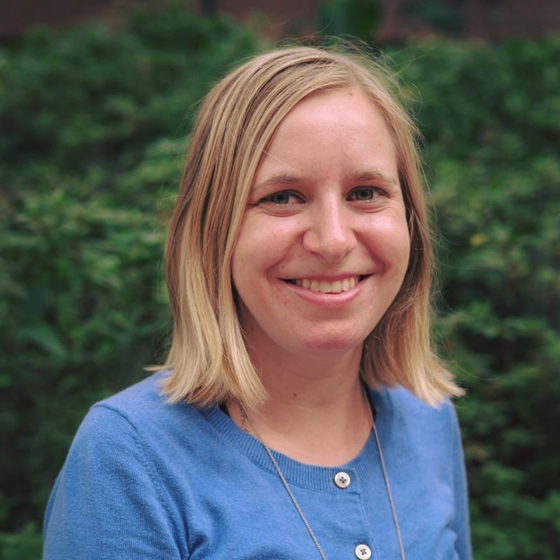
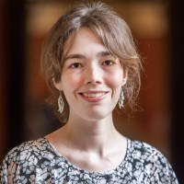
Contact Information
STRATEGIC RESEARCH DEVELOPMENT
Future workshops/events:
https://research.ufl.edu/srd/workshops-trainings.html
Limited Submissions:
limitedprograms@research.ufl.edu
Research Development: researchdevelopment@research.ufl.edu
Internal Seed Fund Programs: opportunityfund@research.ufl.edu
Gail Fish
gail.fish@ufl.edu
352-294-0571
Ashley Ray, Ph.D.
ashley.ray@ufl.edu
352-392-9270
Notes:
Here is some information on future workshops/events offered by SRD. We have put the contact information for a few programs managed through SRD as well as our contact information. Please feel free to reach out!

