Slide 1
College of Education Spring Faculty Meeting
February 23, 2015
3:00pm – 4:30pm
Terrace Room

Slide 2
AGENDA
Welcome
FPC Actions 2014-2015 James McLeskey
FPC Issues for 2015-2016 Albert Ritzhaupt & Ana Puig
Constitutional Amendment
Dean’s Report Glenn Good
Open discussion

Slide 3
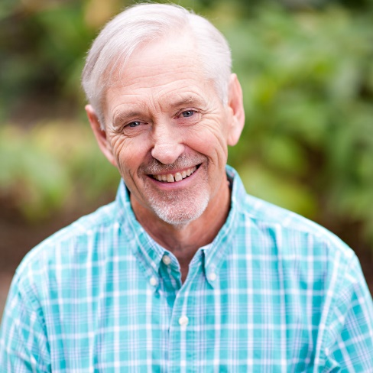
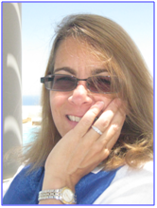
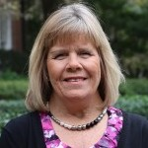
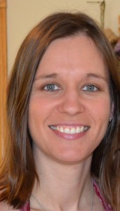
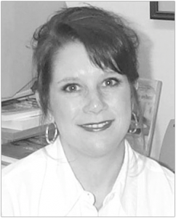
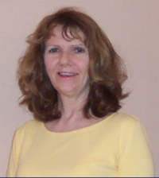
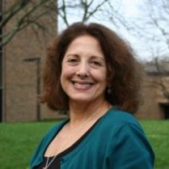
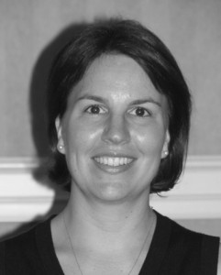
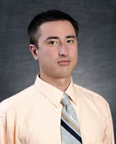
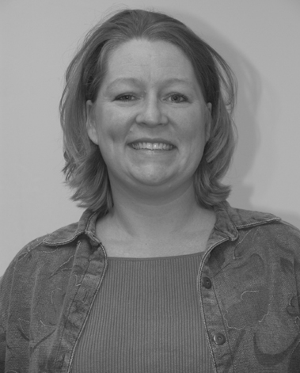
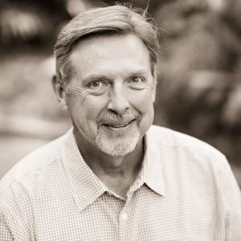
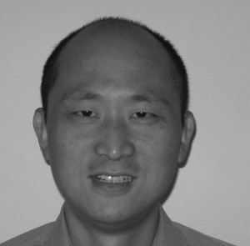
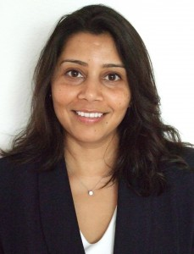
FPC 2014-2015

Slide 4
College Committees
Budgetary Affairs
Curriculum
Diversity
Faculty Affairs
Lectures, Seminars & Awards
Long Range Planning
Research
Technology & DE
Professional Development Leave
Sabbatical Leave
Promotion & Tenure
UF Senate

Slide 5
 | FPC Representative Dean’s Representative | HDOSE | SESPECS | STL
FPC | James McLeskey* Ana Puig (FPC Secretary) Dean: Good, Dana | Jann MacInnes (1) Jacqueline Swank (1) Ana Puig (2) Sondra Smith (2) Patricia Hurff (Alt) | Diana Joyce Beaulieu (1) Linda Lombardino (1) Elayne Colon (2) Paul Sindelar (2) Hazel Jones (Alt) | Alyson Adams (1) Albert Ritzhaupt (1) Zhihui Fang (1) Swapna Kumar (2)
Agenda | James McLeskey* Ana Puig Albert Ritzhaupt Dean: Good, Dana | NA | NA | NA
Budgetary Affairs | Zhihui Fang (FPC Rep) Dean: Good, Dana Staff: Sandra Bass | David Therriault (1) Dennis Kramer (2) | Holly Lane (1) Stephen Smith# (2) | Linda Jones (1) Zhihui Fang* (2)
Curriculum | Elayne Colon (FPC Rep) Dean: Dana, Waldron | Diane Porter Roberts (1) Catherine Emihovich (2) | Nicholas Gage (1) Hazel Jones* (2) | Shelly Warm (1) Eileen Oliver (2)
Diversity | Jann MacInnes Dean: Waldron | Jann MacInnes* (1) John Super (2) | Ashley MacSuga-Gage (1) Penny Cox (2) | Vicki Vescio (1) Crystal Timmons (2)
Faculty Affairs | Alyson Adams Dean: Dana, Adams | Sondra Smith* (1) Pat Ashton (2) | Kristen Kemple# (1) Cyndy Griffin (2) | Alyson Adams (1) Kara Dawson (2)
Lectures, Seminars & Awards | Albert Ritzhaupt Dean: Adams, Waldron | Corinne Manley (1) Kristina DePue* (2) | Nancy Corbett (1) Mary McLean (2) | Susan Butler (1) Albert Ritzhaupt (2)
Long Range Planning | Diana Joyce Beaulieu Dean: Good, Dana | David Miller (1) Corinne Manley (2) | Paul Sindelar (1) John Kranzler (2) | Linda Jones* (1) Jane Townsend (2)
Research | Jacqueline Swank Dean: Adams | Jacqueline Swank (1) Ellen Amatea (2) | Maureen Conroy (1) Brian Reichow (2) | Brianna Kennedy (1) Sevan Terzian* (2)
Technology & Distance Ed | Swapna Kumar Dean: Dana | Bruce Mousa* (meets via technology) (1) Linda Eldridge (2) | Jeanne Repetto* (1) Meg Kamman (2) | Suzy Colvin (1) Swapna Kumar (2)
Promotion & Tenure | Dean: Adams | David Miller Craig Wood | Cyndy Griffin John Kranzler | Nancy Dana Kara Dawson

Slide 6
FPC 2014-2015 A Year of Transition and Exploration
Examining the COE Long Range Plan
Constitutional Amendments
Exploring issues
Professor of Practice
Best practices regarding supporting a diverse faculty
Implementing CANVAS
Addressing enrollment and budget issues
Changes in budget rules

Slide 7
FPC 2014-2015 A Year of Transition and Exploration
Celebrating
A new president
New colleagues (and more on the way)
Faculty engagement in shared governance (72%)
Raises
A very promising future

Slide 8
FPC Issues for 2015-2016
Need Unified Vision and Goals for the COE of the Future
Develop connection to President Fuchs early on
Address Enrollment Issue
Address Budgetary Issues Resulting from the above
Solidify plans for launching Online UG Programs
Role and Status of the Non-Tenure Track Faculty
Expectations for Leadership and Service
Review and revise outdated documents in the FPC website
Archive old documents no longer relevant

Slide 9
Constitutional Amendment
ARTICLE II-The Faculty
Section 4-Councils and Committees
C. Presiding Officer
The Chair shall preside at meetings of the Faculty Policy Council and shall be a nonvoting member. The Chair of the Faculty Policy Council shall have .25 released time (or equivalent funding that may include a graduate assistant, professional travel, summer salary, and so forth), reached in agreement with his/her chair or director, for the fall and spring semesters. The Chair of the Faculty Policy Council shall attend the Dean’s Administrative Council meetings, preside at faculty meetings, and chair the Agenda Committee.
D. Chair-Elect
The Faculty of the College of Education shall elect a tenured or promoted non-tenure track member to serve as Chair-Elect of the Faculty Policy Council. The Chair-Elect is a voting member of the Council. The Chair-Elect shall also function as Secretary of the Council. The Chair-Elect of the Faculty Policy Council shall have .25 released time (or equivalent funding that may include a graduate assistant, professional travel, summer salary, and so forth), reached in agreement with his/her chair or director, for the fall and spring semesters. The Chair-Elect shall become the Chair of the Faculty Policy Council the following year. Each School shall be invited to put forward nominations for the position of Chair-elect from their School. Elections shall be held in conjunction with the general FPC Council Elections

Slide 10
Dean’s Report
Glenn Good

Slide 11
Open Discussion

