Slide 1
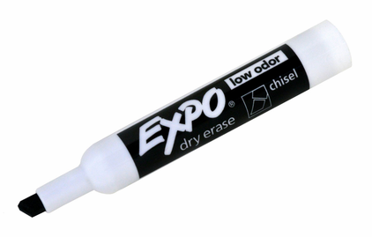
Sentence Writing
The cat is on
the mat.

Slide 2
C
Capitalization
The dog runs.
A
Appearance
My sentence looks great!
P
Punctuation
. ? !
S
Spelling

