Slide 1
No Century Gothic?
No problem. Follow these steps.

Slide 2
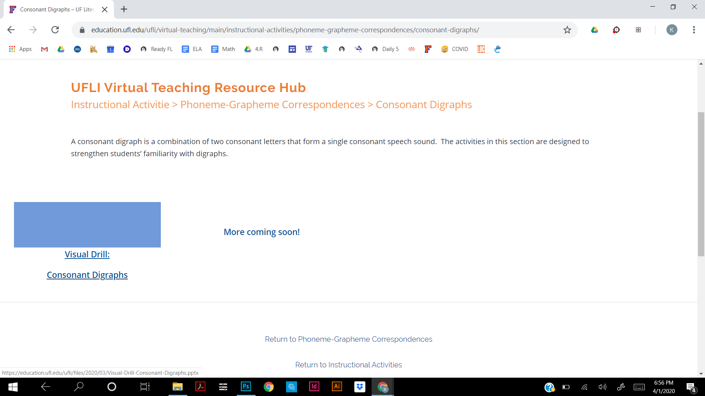
Step 1: Click on the PowerPoint to download it.

Slide 3
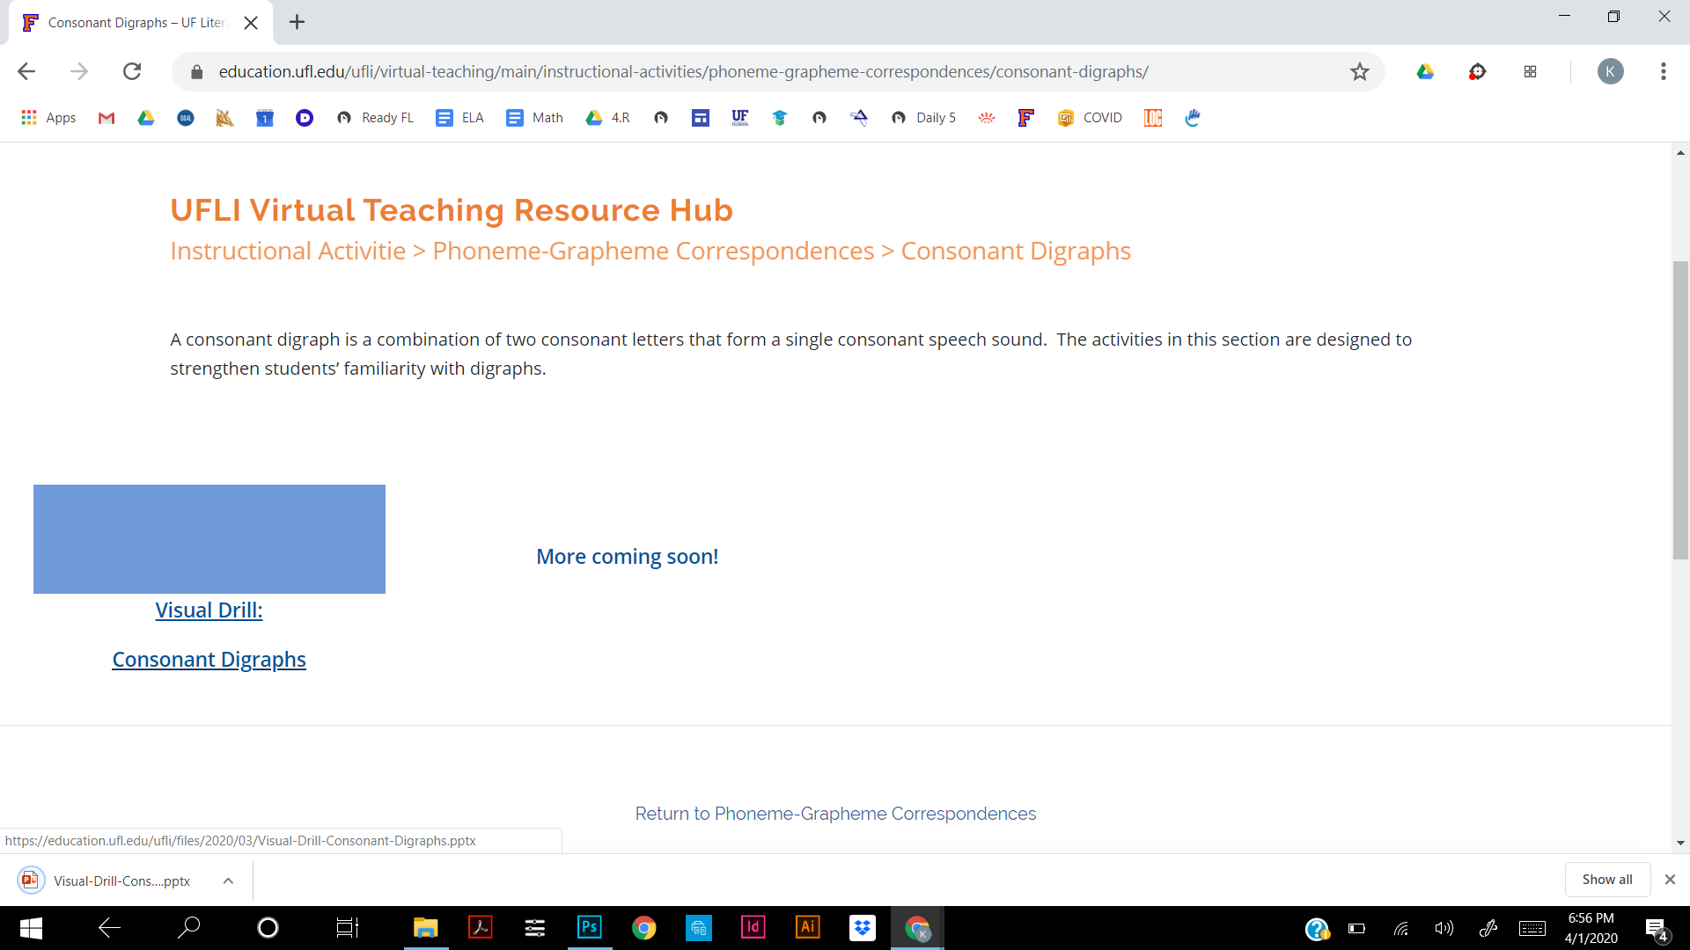
Step 1: You should see this if it downloaded.

Slide 4
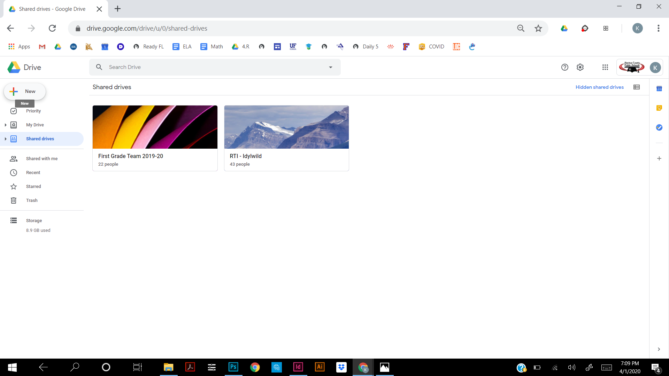
Step 2: Go to Google Drive. Click “New.”

Slide 5
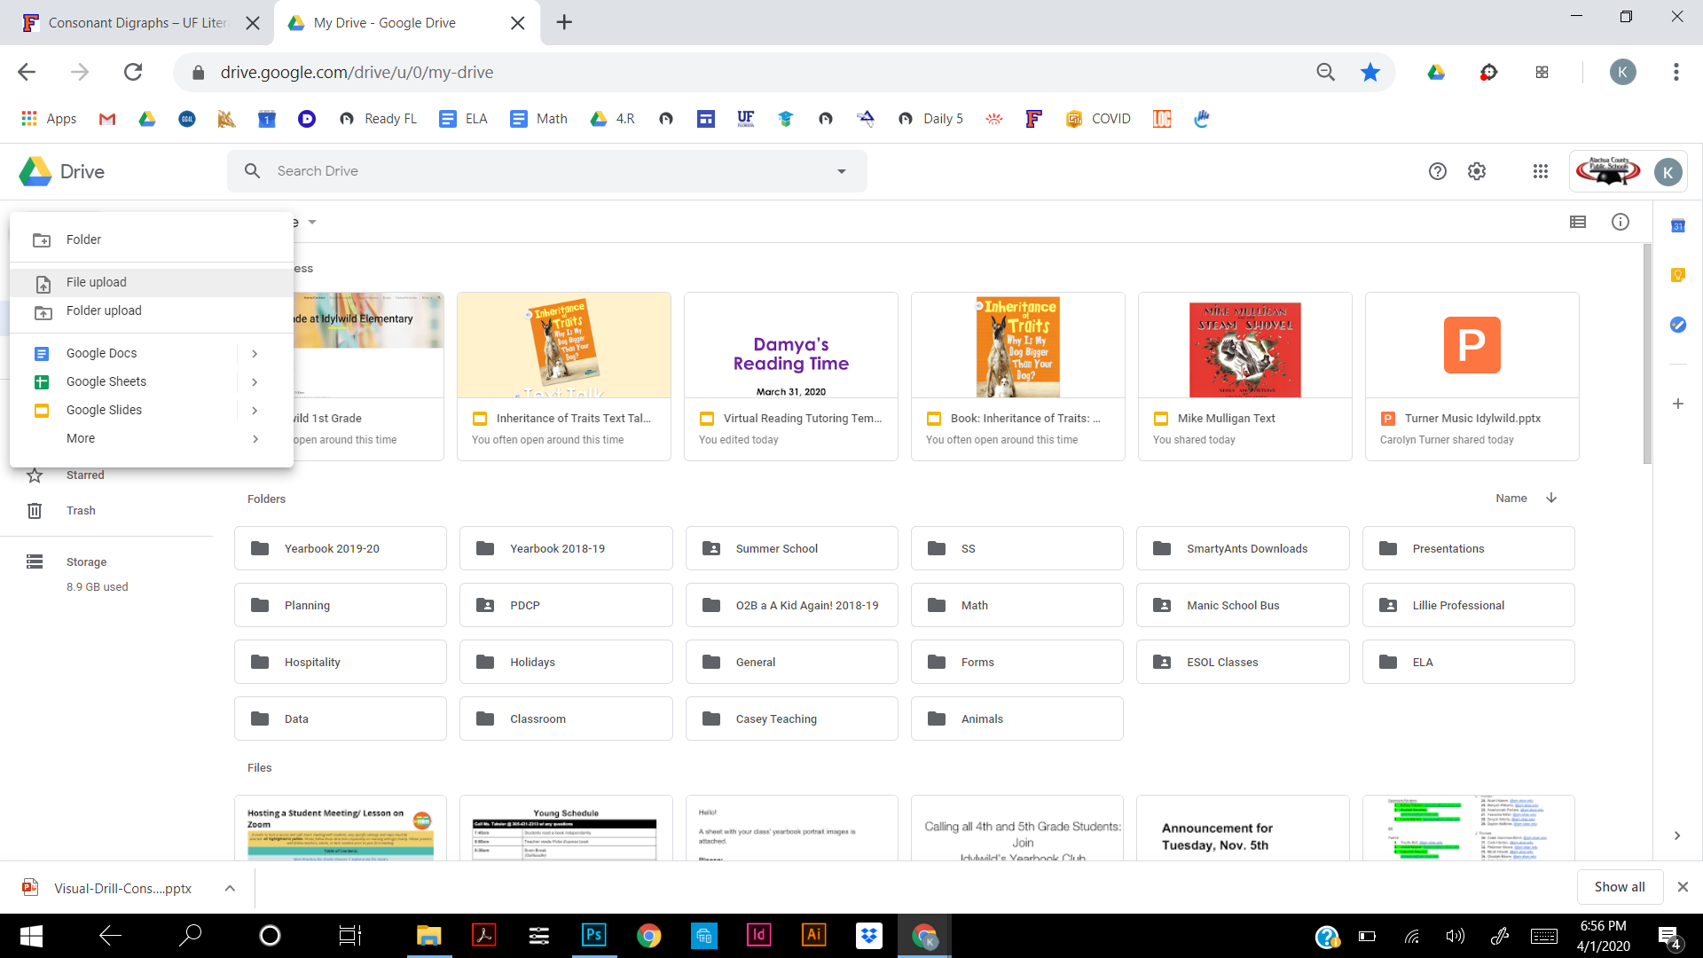
Step 3: Click “File upload.”

Slide 6
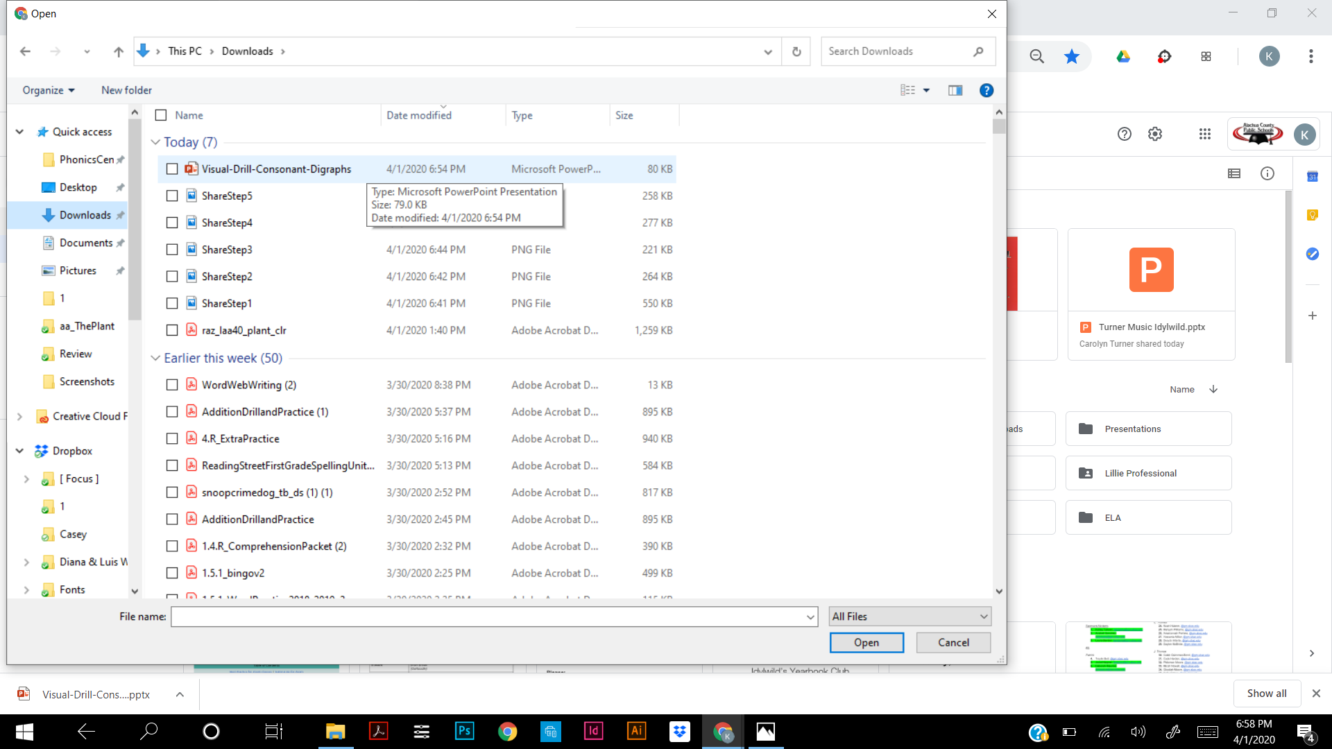
Step 4: Double-click the PowerPoint file.

Slide 7
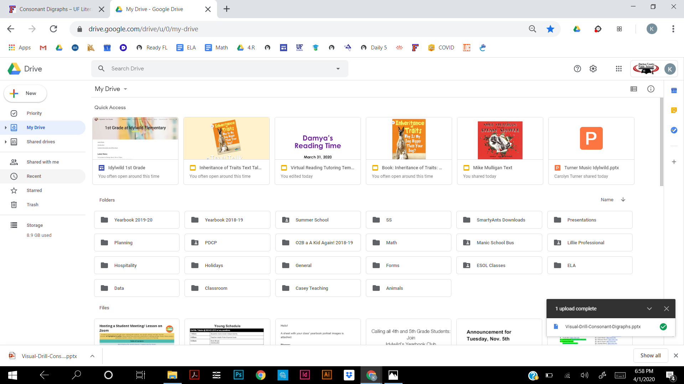
Step 5: Click on “Recent.”

Slide 8
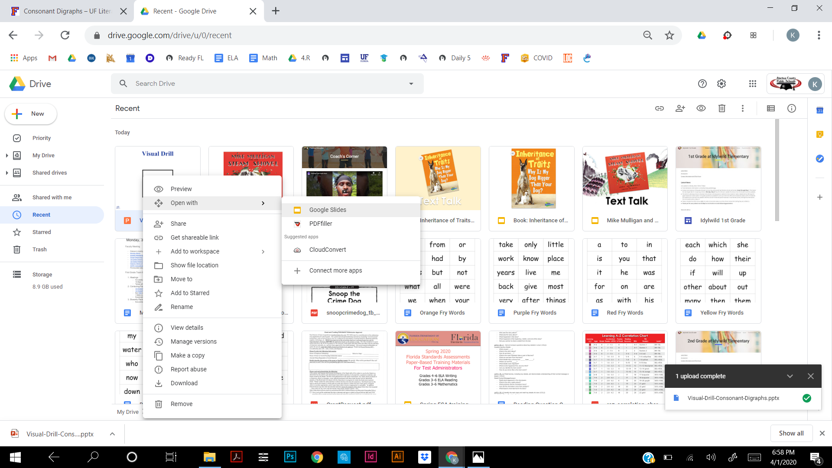
Step 6: Right click on the PowerPoint. Click on “Open with,” then “Google Slides.”

Slide 9
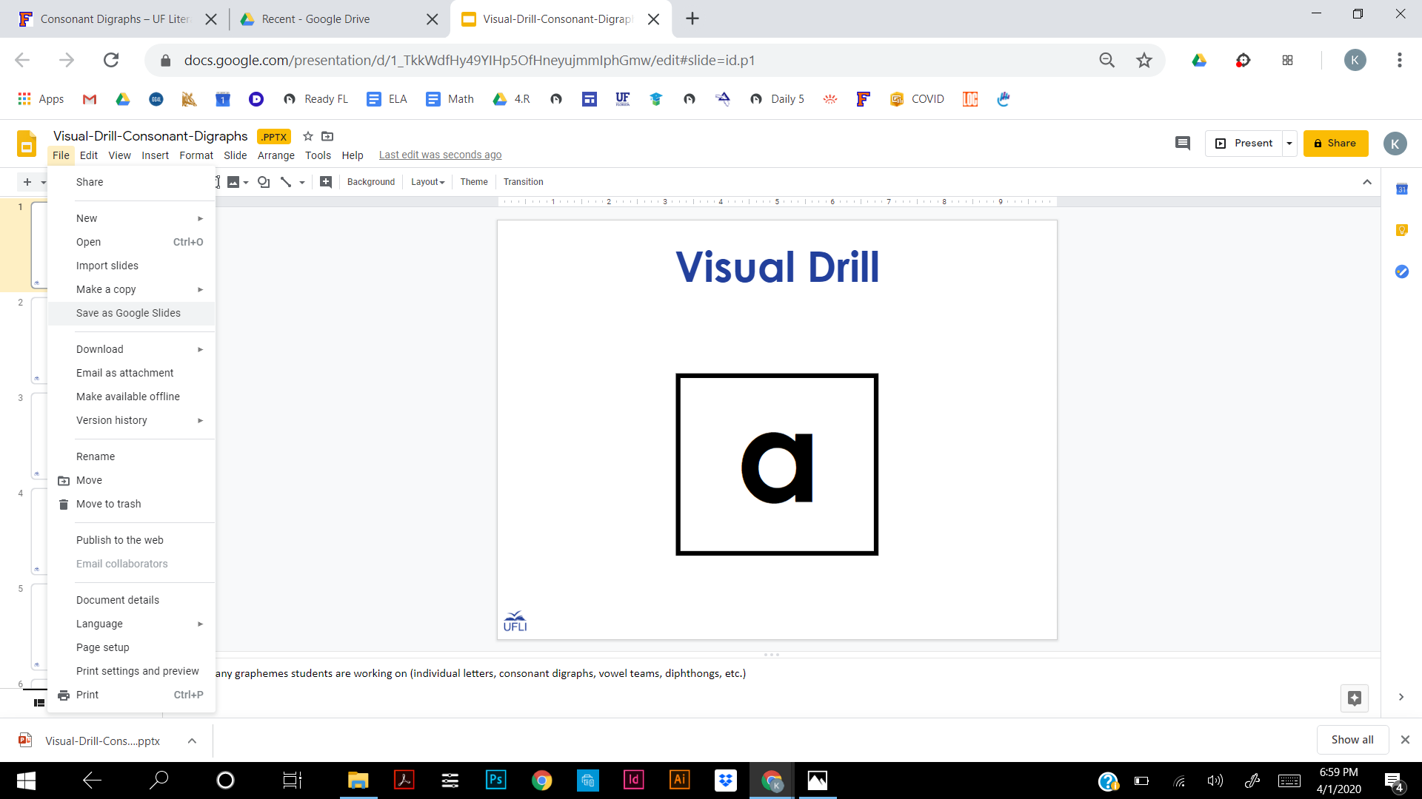
Step 7: If you want to be able to edit it, click on “File,” then “Save as Google Slides.”

Slide 10
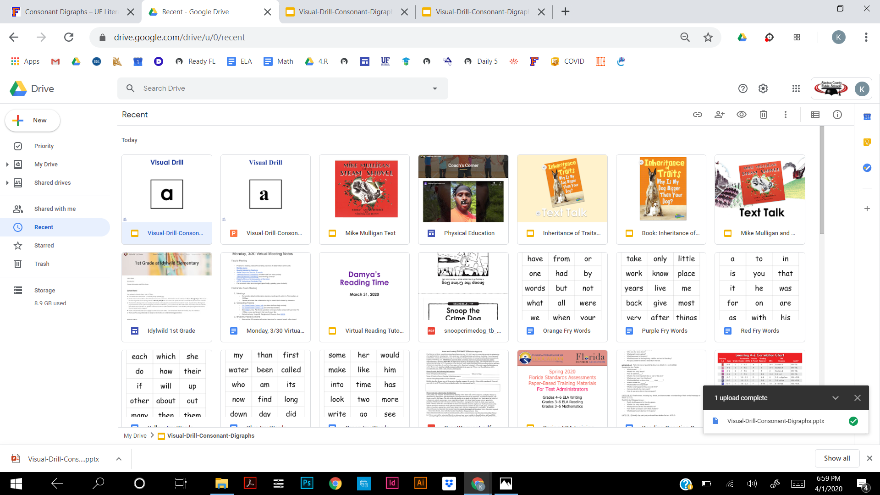
Step 8: Make sure you open the file that has the yellow/white rectangle, not the PPT icon. It helps to delete the PPT file from your Google Drive.

